Slide 1




SBIRT
with adult patients
Jim Winkle, MPH
Updated June, 2026

Slide 2
Outline
    Reimbursement and EHR tools
    Brief intervention
      Styles of communication
      Brief intervention model
      Role play practice
    Referral to treatment
      Harm Reduction
      Treatment
    Why SBIRT?
      Relevance to medical care
      Categories of use
      Prevalence and morbidity
      Implementation
    Screening
      Brief screen
      AUDIT
      DAST

Slide 3
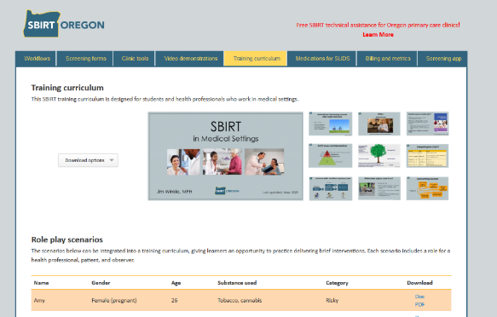

Website: sbirtoregon.org
    Demonstration videos
    Screening forms
    Reimbursement information
    Pocket cards and tools
    Training curriculum
    Screening app

Slide 4
SBIRT
Screening
Brief Intervention
Referral to Treatment
    “A public health approach to the delivery of early intervention and treatment services for people with substance use disorders and those at risk of developing these disorders.”
SAMHSA
Notes:
SBIRT is an acronym that stands for Screening, Brief Intervention, and Referral to Treatment. It is an evidence-based method that is currently underemployed in medical settings. Note that this definition, provided by SAMHSA, describes SBIRT as a “public health” approach. Addressing substance use is relevant to the care of individual patients and clients, but medical settings, like correctional facilities and college campuses, are targets for SBIRT implementation because of the large population they serve.
Citation: http://beta.samhsa.gov/sbirt

Slide 5
SBIRT
Adults
Adolescents
Pregnancy
Brief screen
AUDIT
DAST
CRAFFT
5Ps
Method
Populations
Common screening tools
Notes:
Sometimes the acronym “SBIRT” is incorrectly used as a verb or used to describe a screening tool. This diagram illustrates the different definitions of the terms used in this presentation.

Slide 6
Why SBIRT?
Notes:
Let’s look at why SBIRT is relevant to the medical care of patients.

Slide 7

Relevance to medical settings
    Significant prevalence of unhealthy substance use among pts
    Substantial associated morbidity, mortality, and health care cost
    Valid screening instruments
    Interventions are effective, inexpensive, and feasible
Notes:
A preventative service needs to meet certain criteria to justify universal and routine implementation in a busy medical setting. In the case of SBIRT, unhealthy alcohol and drug use is prevalent among patients, is associated with significant illness and death, is detectable through the use of validated screening tools, and can be addressed with interventions that are both effective and feasible in a busy clinic setting.

Slide 8
SBIRT vs. business as usual
SBIRT implemented | No SBIRT
Routine and universal screening, regardless of medical complaint | Inconsistent, selective screening
Validated screening tools | Non-systemized narrative questions
Substance use defined as a continuum | Substance use defined as dichotomous
Interventions: evidence-based, patient-driven discussion | Ineffective, directive, or no discussion
Recognizes patient is more than their substance use | Patient is defined by their use
Notes:
Many providers believe they already adequately address substance use without SBIRT processes in place, but there are important differences. With SBIRT implemented:
All patients are automatically screened for substance use, as opposed to relying on the chance that clinicians address it with only the patients who warrant screening.
Validated screening tools can do much of the work in identifying unhealthy substance use, while untested questions may not provide useful information.
Many clinicians view alcohol use under an alcoholic vs. non-alcoholic dichotomy, while SBIRT recognizes that substance use falls along a spectrum.
Brief interventions are evidence-based and employ Motivational Interviewing, as opposed to directing a patient to change their behavior.
Patients receiving specialized treatment for substance use continue to receive care from their PCP under SBIRT.

Slide 9
Categories of substance use
Number of consequences
Disorder
Risky
Frequency of use
Low or
no risk
Notes:
These are commonly used categories that stratify alcohol and drug use. The largest number of people fall into the Low-risk zone. We will look at how each category is defined.

Slide 10
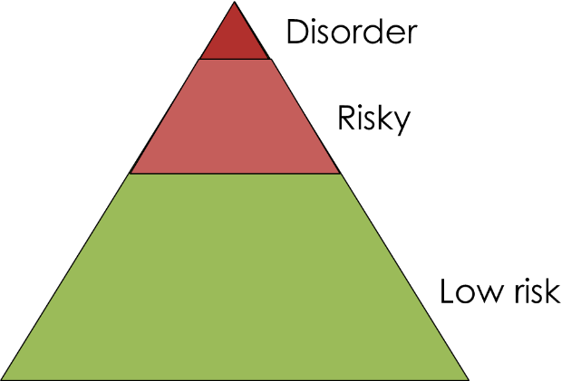
Low risk
    Defined by:
      No use, or
      Adult alcohol use under risky limits
    Low-risk limits do not (yet) apply to cannabis or other drug use
Notes:
The Low risk zone is defined by abstention from any use, or adult use of alcohol at low risk amounts. Low risk amounts have not been established for drug use or for adolescent alcohol use.

Slide 11
Risky
    Risky use defined as:
    Adult alcohol use that exceeds risky limits
    Any adolescent use
    Any recreational drug use
    And not experiencing repeated related consequences in last 12 months
Notes:
The Risky zone is defined by adult drinking above low-risk alcohol limits, adolescent use of any substance without associated problems, or any drug use without associated problems. Individuals in the Risky zone are not currently experiencing negative consequences from use, but are likely to create new health problems or make existing ones worse over time. Any drug use is considered risky – partly because we do not yet know what amount of drug use poses short and long term risk, and because most drugs remain criminalized, which means pts can face consequences from a urine test at work or legal trouble.

Slide 12
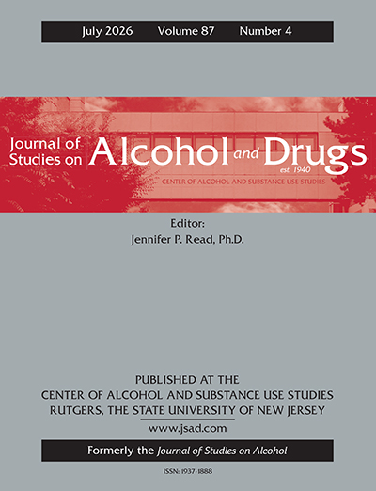
New low-risk limits in the U.S.
    Federally commissioned report:
    Americans should limit themselves to no more than one drink a day
    Moderate drinking increases the risk of early death and diseases such as cancer, heart disease and liver disease, and provides no net positive health benefit
    14 drinks a week was associated with a 1 in 25 chance of an alcohol-related death.
    “There is no safe level of alcohol.”
George S, Naimi TS, Keyes K, et al. 2026
Notes:
George S, Naimi TS, Keyes K, et al. Alcohol Intake and Health Study: No Protective Effect at Low Levels, With Mortality Increasing to 1 in 25 at 14 Drinks Per Week. Journal of Studies on Alcohol and Drugs. 2026;87(4):621-638. doi:10.15288/jsad.25-00435

Slide 13
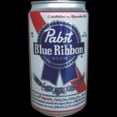
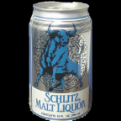
Standard drinks in the U.S.
Standard drink in the U.S. defined as: 0.6 fluid ounces (14 grams) of pure ethanol
 | Volume | Standard drinks
Beer | 12 oz | 1
 | 16 oz | 1.3
 | 22 oz | 2
 | 40 oz | 3.3
Malt liquor | 12 oz | 1.5
 | 16 oz | 2
 | 22 oz | 2.5
 | 40 oz | 4.5
NIAAA
Notes:
When gauging number of drinks consumed, it’s necessary to know what counts as one drink. In the U.S., a standard drink contains 0.6 fluid ounces of pure alcohol (14 grams or about 1.2 tablespoons), which comes in a variety of servings of beer, malt liquor, wine and liquor.
Citation: National Institute on Alcohol Abuse and Alcoholism. http://pubs.niaaa.nih.gov/publications/Practitioner/PocketGuide/pocket_guide2.htm

Slide 14
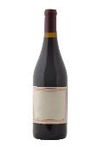
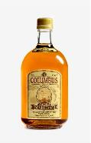
Standard drinks, cont.
 | Volume | Standard drinks
Wine | 5 oz | 1
 | 750-mL bottle | 5
 | 1.5 liter bottle | 9
 | 5 liter box | 30
Liquor (80 proof) | 1 mixed drink | 1
 | 1 pint (16 oz.) | 11
 | One fifth (25 oz.) | 17
 | 1.75 liters (59 oz) | 39
NIAAA
Notes:
When gauging number of drinks consumed, it’s necessary to know what counts as one drink. In the U.S., a standard drink contains 0.6 fluid ounces of pure alcohol (14 grams or about 1.2 tablespoons), which comes in a variety of servings of beer, malt liquor, wine and liquor.
Citation: National Institute on Alcohol Abuse and Alcoholism. http://pubs.niaaa.nih.gov/publications/Practitioner/PocketGuide/pocket_guide2.htm

Slide 15
Personal factors correlated with risky drinking levels
    Race
    Drinking on a full or empty stomach
    Young versus older adults
    Tolerance
    People may under-report use
    Risk factors for alcohol complications
    History of AUD or treatment
    Variations in self report
    Ethnicity
    Body Mass Index
    People currently in recovery
    Certain medications
    Family history of cancer, heart disease
    Genetics
    Context/environment
    Country of origin
Stockwell, 2012
Notes:
Citation: Stockwell, T. “Constructing and responding to low-risk drinking guidelines:
Conceptualisation, evidence and reception.” Drug and Alcohol Review (March 2012), 31, 121–125
DOI: 10.1111/j.1465-3362.2011.00416.x

Slide 16
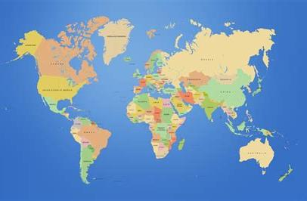
    Gender and alcohol limits
    Drinking guidelines in U.S., Australia, U.K., Portugal, and South Africa don’t distinguish in gender.
    Among 33 countries that apply binary gender categories, low risk limits range from:
      10 – 42g a day for women
      84 – 140g a week for women
      10 – 56g a day for men
      100 – 280g a week for men
Kalinowski and Humphreys, 2016
Notes:
Citation: Kalinowski A and Humphreys K (2016) Governmental Standard Drink Definitions and Low-Risk Alcohol Consumption Guidelines in 37 Countries. Addiction 111: doi:10.1111/add.13341

Slide 17
Disorder
    Official term: Substance Use Disorder
    “Abuse”, “dependence” or “alcoholism” are terms no longer used
    Criteria: 11 consequences experienced in last 12 months
      2 - 3 symptoms: mild
      4 - 5 symptoms: moderate
      6+ symptoms: severe
American Psychiatric Association, 2013
Notes:
When someone is experiencing consequences from their use, they likely fall into the Disorder category. The DSM-5 Manual defines substance use disorders as a spectrum of repeated negative consequences associated with use.
Citation: Diagnostic and Statistical Manual of Mental Disorders: Diagnostic and Statistical Manual of Mental Disorders, Fifth Edition. Arlington, VA: American Psychiatric Association, 2013.

Slide 18
11 criteria that define SUDs
    Taking the substance in larger amounts or for longer than you're meant to.
    Wanting to cut down or stop using the substance but not managing to.
    Spending a lot of time getting, using, or recovering from use of the substance.
    Cravings and urges to use the substance.
    Not managing to do what you should at work, home, or school because of substance use.
    Continuing to use, even when it causes problems in relationships.
    Giving up important social, occupational, or recreational activities because of substance use.
    Using substances again and again, even when it puts you in danger.
    Continuing to use, even when you know you have a physical or psychological problem that could have been caused or made worse by the substance.
    Needing more of the substance to get the effect you want (tolerance).
    Development of withdrawal symptoms, which can be relieved by taking more of the substance.
American Psychiatric Association, 2013
Notes:
Eleven criteria define substance use disorder, according to the Diagnostic and Statistical Manual of Mental Disorders, Fifth Edition.
Citation: Diagnostic and Statistical Manual of Mental Disorders: Diagnostic and Statistical Manual of Mental Disorders, Fifth Edition. Arlington, VA: American Psychiatric Association, 2013.

Slide 19
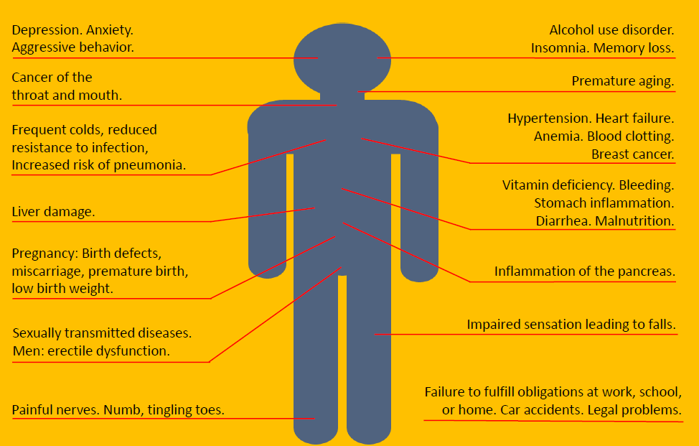
  Morbidity associated with risky adult drinking
Notes:
Why is it important to intervene when patients have unhealthy alcohol use? Unhealthy alcohol use contributes to a range of acute and chronic health consequences, from injuries resulting from traffic crashes to cancer and cardiovascular disease.

Slide 20
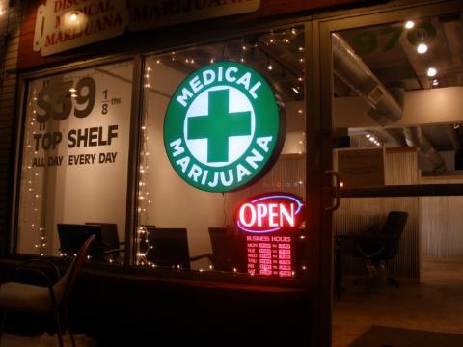
Correlations of heavy cannabis use during adulthood
    Infrequent use:
      Car accidents
    Frequent, long term use:
      Cannabis Use Disorder study: almost 20% of lifetime users
      Anxiety and depression
      Psychoses
      Respiratory problems
Hasin DS, 2018. Volkow et al, 2014.
Notes:
Casual cannabis use among adults is not associated with significant morbidity. Like all intoxicatin substances, cannabis use should be avoided when driving. More frequent, longer term use is linked to an increased risk of addiction and mental health disorders. However, a causal relationship has not been established.
Citations: Hasin DS. US Epidemiology of Cannabis Use and Associated Problems. Neuropsychopharmacology. 2018;43(1):195-212. doi:10.1038/npp.2017.198. https://www.ncbi.nlm.nih.gov/pmc/articles/PMC5719106/
Volkow ND, Baler RD, Compton WM, Weiss SR. Adverse health effects of marijuana use. N Engl J Med. 2014;370(23):2219-2227. doi:10.1056/NEJMra1402309. https://northstarbehavioral.com/wp-content/uploads/2015/06/Adverse-Health-FX-Cannabis-Volkow-NEJM-2014.pdf
Image: free google image

Slide 21
Implementation
Notes:
Now that we have looked at the reasons why SBIRT is an important part of medical care, let’s look at screening specifically.

Slide 22
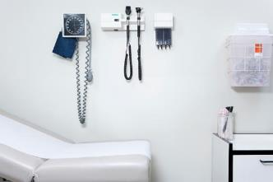
Missed opportunities with adult pts
    Percent of adults ever discussing alcohol use with a health professional:
    16% of U.S. adults overall
    17% of current drinkers
    25% of binge drinkers
    35% of those who binge drink ≥10 times in the past month
CDC, 2014
Notes:
Unfortunately, studies show few patients report being asked about alcohol or drug use by their health care provider. Even patients who drink heavily.
Citation: Centers for Disease Control and Prevention: “Vital Signs: Communication Between Health Professionals and Their Patients About Alcohol Use — 44 States and the District of Columbia, 2011.” http://www.cdc.gov/mmwr/preview/mmwrhtml/mm6301a4.htm?s_cid=mm6301a4_w

Slide 23
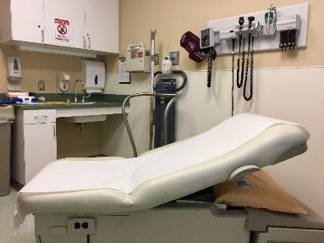
SBIRT and Alcohol Use Disorder
    Study: 80% of people with AUD had medical visit in last year
    70% of these people were asked about their alcohol intake.
    Only one in 10 were encouraged to cut back on their drinking by a health professional
Mintz, et al. 2021
Notes:
Citation: Mintz CM, Hartz SM, Fisher SL, Ramsey AT, Geng EH, Grucza RA, Bierut LJ. A cascade of care for alcohol use disorder: Using 2015-2019 National Survey on Drug Use and Health data to identify gaps in past 12-month care. Alcohol Clin Exp Res. 2021 Jun;45(6):1276-1286. doi: 10.1111/acer.14609. Epub 2021 May 16. PMID: 33993541; PMCID: PMC8254783.
https://pubmed.ncbi.nlm.nih.gov/33993541/

Slide 24
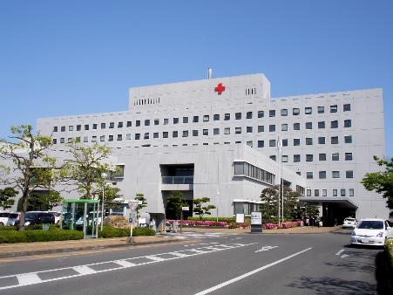
Inpatient hospital stays
    Among patients admitted for alcohol-related diseases:
    Only 52% of pts with alcohol-associated hepatitis received SBIRT
    Only 24% of pts with decompensated alcohol-related cirrhosis received SBIRT
Wang D, Puglia M. 2023
Notes:
Citation: Wang D, Puglia M. Inpatient Screening, Brief Intervention, and Referral to Treatment for Alcohol Use Disorder in Patients Admitted with Alcohol-associated Liver Disease Is Not Universally Implemented in Practice, But Can Reduce Readmissions for Alcohol-associated Hepatitis. J Can Assoc Gastroenterol. 2023 Nov 30;7(2):169-176. doi: 10.1093/jcag/gwad048. PMID: 38596805; PMCID: PMC10999764.
https://www.ncbi.nlm.nih.gov/pmc/articles/PMC10999764/

Slide 25
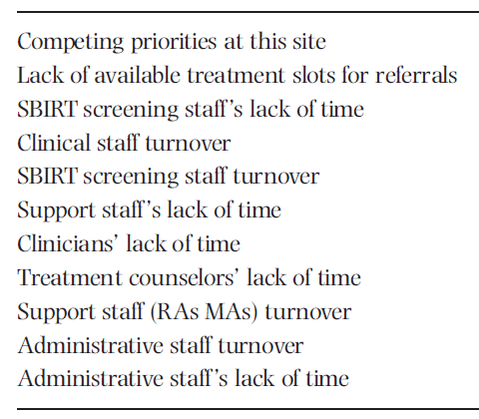
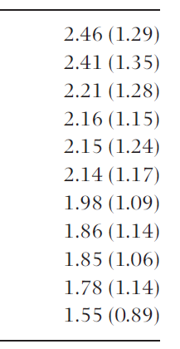
Clinic-wide barriers to implementing SBIRT
    Survey of 102 SBIRT providers and 221 SBIRT stakeholders and staff.
Scale used: 1 = to a very little extent, 3 = to some extent, 5 = to a very great extent. (standard deviation)
Vendetti et al 2017
Notes:
To be fair, providers and staff cite a number of barriers to addressing substance use with patients. Here are the results of a survey of SBIRT providers specifically. However, many of these barriers can be countered, as we’ll see in the next few slides.
Citation: Vendetti J, Gmyrek A, Damon D, Singh M, McRee B, Del Boca F. “Screening, brief intervention and referral to treatment (SBIRT): implementation barriers, facilitators and model migration.” Addiction. 2017, Vol. 112 Suppl 2, p.23-33.

Slide 26

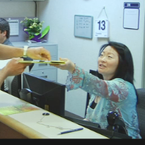
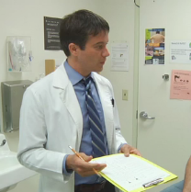
Keys to sustainably implementing SBIRT
    Secure buy-in from leadership
    Identify workflow
    Train all staff and implement ongoing training
    Identify champions
    Optimize EMR
    Use clinic tools (ex: sbirtoregon.org)
Notes:
Whether or not SBIRT processes are sustainably implemented into a medical setting depends on a number of factors.

Slide 27
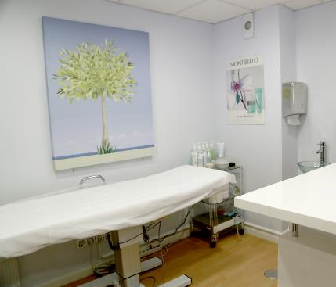
Demographic disparities in SBIRT implementation
      People less likely to be screened for alcohol use:
        Ages ≥50, racial and ethnic minorities, uninsured
      People less likely to receive BI or RT:
      Women, ages 18-25, Asian Americans
      People less likely to accept treatment:
      Men, Black Americans
Mintz et al, 2023
Notes:
Citation: Mintz CM, Knox J, Hartz SM, Hasin DS, Martins SS, Kranzler HR, Greene E, Geng EH, Grucza RA, Bierut LJ. Demographic differences in the cascade of care for unhealthy alcohol use: A cross-sectional analysis of data from the 2015-2019 National Survey on Drug Use and Health. Alcohol Clin Exp Res (Hoboken). 2023 Oct;47(10):1890-1903. doi: 10.1111/acer.15176. Epub 2023 Sep 10. PMID: 37864538.

Slide 28


Beware: when implementing SBIRT
    Many states consider drug use during pregnancy to be child abuse
    Pts identified with drug use face greater stigma when receiving heath care
    Efficacy of brief intervention depends on fidelity and quality – easier to ensure during trials compared to practice.
Saitz, JAMA, 2020
Notes:
Citation: Saitz R. “Screening for Unhealthy Drug Use - Neither an Unreasonable Idea Nor an Evidence-Based Practice.” JAMA. June 9.2020 Volume 323, Number 22

Slide 29
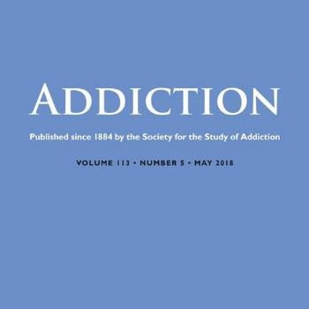
Large brief intervention study
      Study question: is BI associated with treatment for AUD?
      Analysis of VA pt records 2009-2013
      830,825 outpatients screened positive for unhealthy alcohol use, 74% had documented BI within 0-14 days
      Result: BI was associated with lower likelihood of receiving specialty treatment
Frost MC, Glass JE, Bradley KA, Williams EC. “Documented brief intervention associated with reduced linkage to specialty addictions treatment in a national sample of VA patients with unhealthy alcohol use with and without alcohol use disorders”. Addiction. 2019 Oct 22.
Notes:
Frost MC, Glass JE, Bradley KA, Williams EC. Documented brief intervention associated with reduced linkage to specialty addictions treatment in a national sample of VA patients with unhealthy alcohol use with and without alcohol use disorders. Addiction. 2019 Oct 22. https://europepmc.org/backend/ptpmcrender.fcgi?accid=PMC7725424&blobtype=pdf
BIs defined by giving advice and information about risks

Slide 30
Table: Percent of VA pts who received treatment within 365 days
 | Adjusted* % | 95% CI | Rate ratio | P-value
Overall sample: (N= 1,172,606 positive screens)
No documented BI | 12.6 | (12.5-12.7) | .84 | <0.001
Documented BI | 10.5 | (10.4-10.6)
AUD diagnosis in the past year: (N= 421,244 positive screens)
No documented BI | 19.9 | (19.7-20.1) | .83 | <0.001
Documented BI | 16.5 | (16.4-16.6)
*“Adjusted for sex, age, race/ethnicity, marital status, VA eligibility status, mental health and drug use disorder diagnoses, tobacco use, AUDIT-C category, alcohol use disorder diagnosis, alcohol-specific condition, and fiscal year in which positive AUDIT-C screen occurred.”
Frost, et al. Addiction. 2019

Slide 31
Study takeaways
      BIs in the VA were defined as only giving information and advice
      Conclusion: poor BIs may cause harm with pts with SUDs.
      The quality of the BI matters!
Frost, et al. Addiction. 2019
Notes:
Frost MC, Glass JE, Bradley KA, Williams EC. Documented brief intervention associated with reduced linkage to specialty addictions treatment in a national sample of VA patients with unhealthy alcohol use with and without alcohol use disorders. Addiction. 2019 Oct 22. doi: 10.1111/add.14836.
BIs defined by giving advice and information about risks

Slide 32
Meta studies: primary care interventions for unhealthy alcohol use
 | S for balance of benefits versus harms | SBI for reducing use or negative outcomes | SBIRT for patient receipt of specialty treatment
Adults | Moderate certainty: “small to no harm” | Moderate evidence | Evidence for null effect*
Adolescents | Insufficient evidence | Insufficient evidence | ?
Pregnancy | Moderate certainty: “small to no harm” | Moderate evidence | ?
USPSTF, 2018. *Glass et al, 2015
Notes:
“Potential harms of screening include stigma, labeling, discrimination, privacy concerns, and interference with the patient-clinician relationship. In addition, there may be legal concerns for pregnant women in some states. No studies evaluated the harms of screening for unhealthy alcohol use.
One possible harm of behavioral counseling interventions could be an unexpected paradoxical increase in alcohol consumption. One good-quality and 5 fair-quality trials (n = 3650) reported on harms. There was very limited evidence on intervention harms.¹ Interventions reviewed and discussed above generally reported benefits, including reductions in alcohol consumption. Therefore, paradoxical and theoretical increases in alcohol use with interventions are unlikely.
Curry S, Krist A, Owens D, Barry M, Caughey A, Davidson K, Doubeni C, Epling J, Kemper A, Kubik M, Landefeld C, Mangione C, Silverstein M, Simon M, Tseng C-W, Wong J. Unhealthy Alcohol Use in Adolescents and Adults: Screening and Behavioral Counseling Interventions. JAMA. 2018;320(18):1899-1909. doi:10.1001/jama.2018.16789. https://www.uspreventiveservicestaskforce.org/uspstf/recommendation/unhealthy-alcohol-use-in-adolescents-and-adults-screening-and-behavioral-counseling-interventions
Glass JE, Hamilton AM, Powell BJ, Perron BE, Brown RT, Ilgen MA. Specialty substance use disorder services following brief alcohol intervention: a meta-analysis of randomized controlled trials. Addiction. 2015;110:1404–15. https://pubmed.ncbi.nlm.nih.gov/25913697/

Slide 33
Meta studies: primary care interventions for illicit drug use
 | S for balance of benefits versus harms | SBI for reducing use or negative outcomes | SBIRT for patient receipt of specialty treatment
Adults | “No evidence” (USPSTF, 2020) “Moderate net benefit when treatment can be offered” (Jin, 2020) | Moderate evidence for null effect (USPSTF, 2020) | ?
Adolescents |  |  | ?
Pregnancy |  |  | ?
Notes:
Patnode CD, Perdue LA, Rushkin M, O’Connor EA. Screening for Unhealthy Drug Use in Primary Care in Adolescents and Adults, Including Pregnant Persons: Updated Systematic Review for the U.S. Preventive Services Task Force. Evidence Synthesis No. 186. AHRQ Publication No. 19-05255-EF-1. Rockville, MD: Agency for Healthcare Research and Quality; 2020. https://www.ncbi.nlm.nih.gov/books/NBK558174/
Jin J. Screening for Unhealthy Drug Use in Adults and Adolescents. JAMA. 2020;323(22):2350. doi:10.1001/jama.2020.8192. https://jamanetwork.com/journals/jama/fullarticle/2766868?resultClick=1

Slide 34
Screening
Notes:
Now that we have looked at the reasons why SBIRT is an important part of medical care, let’s look at screening specifically.

Slide 35
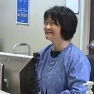


Common in-person clinic workflow
Exam room
Exam room
CRAFFT
Brief
intervention
Waiting room
Brief screen
AUDIT / DAST
Reception
Medical assistant
Clinician
Notes:
These are common SBIRT workflows used by primary care clinics. Notice that adult patients receive a two-step screening process, while adolescent and pregnant patients receive one screening tool in the exam room. These workflows build upon the medical home model and use a team-based approach, rather then rely on clinicians only.

Slide 36

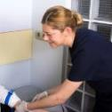

Common ED in-person workflow
Bedside
Bedside
CRAFFT
Brief
intervention
Triage
Brief screen
AUDIT / DAST
Nurse
Nurse or
Social worker
Social worker
Notes:
Workflows in ED settings are similar, but utilize different team members. All adult patients are asked the brief screening questions during triage, and receive full screens from social workers before discharge. Adolescent and pregnant patients receive the full screen when confidentiality is assured before discharge.

Slide 37
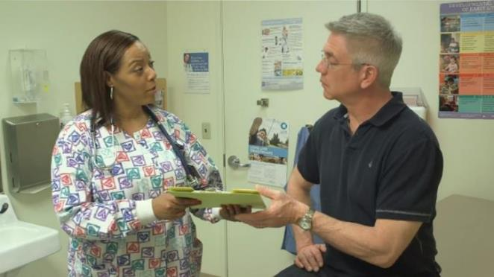
Video:
Primary care workflow with behavioral health specialist
https://www.youtube.com/watch?v=EDc-GNm7gIU
sbirtoregon.org
Notes:
Here is a short video that demonstrates how the SBIRT workflow works for adult patients in a primary care setting. It also demonstrates what a “warm handoff” can look like from clinician to behavioral health specialist.
Video: www.sbirtoregon.org

Slide 38
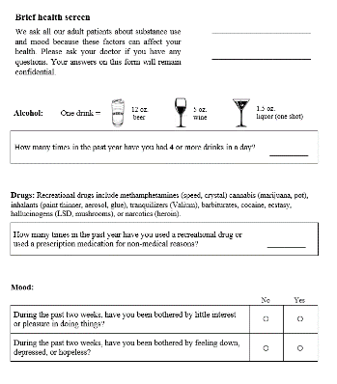
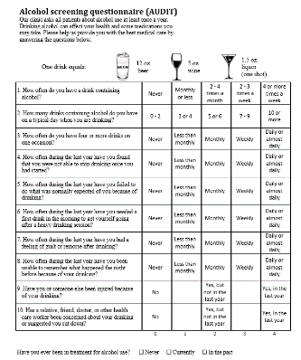
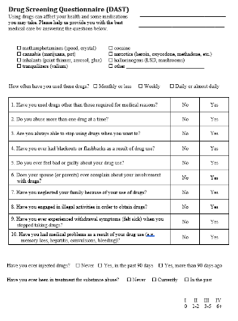
Adult screening tools
Brief screen
AUDIT
DAST
sbirtoregon.org
Notes:
Let’s look at the first step of the workflow for adult patients. The purpose of the Brief screen is to briefly screen all patients over the age of 18 at least once a year. A patient who scores “positive” qualifies for a full screen.
Citation: www.sbirtoregon.org

Slide 39
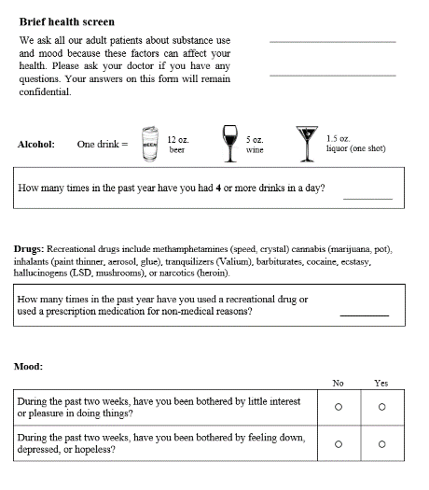
Brief screen
    One alcohol question
    One drug question
www.sbirtoregon.org
Notes:
The Adult brief screen consists of a single validated question for adult alcohol use, and a single validated question for adult drug use. It acts as a “pre-screen” that filters out most patients who do not have unhealthy alcohol or drug use. Included at the bottom are two questions (PHQ-2) for depression. Depression is not part of SBIRT, but many clinics appreciate streamlining depression and substance use screening onto one paper form.
Citation: www.sbirtoregon.org

Slide 40
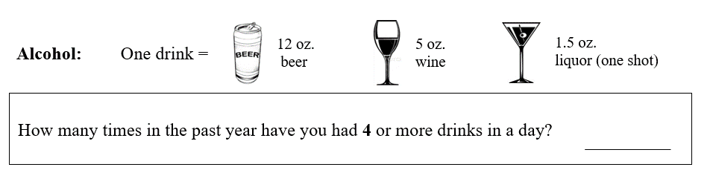
Single alcohol question
Informed by: McNeely , et al. 2015. Flente et al, 2020.
Notes:
Note: The alcohol question asks about four drinks in one day to identify risky drinking among all patients, informed by the validation studies below, as well as a gender inclusive approach to patient care.
Citations:
McNeely J, Cleland C, Strauss S, Palamar J, Rotrosen J, Saitz R. “Validation of Self-Administered Single-Item Screening Questions (SISQs) for Unhealthy Alcohol and Drug Use in Primary Care Patients.” J Gen Intern Med, 30, 1757–1764. 2015.
Flentje A, Barger BT, Capriotti MR, Lubensky ME, Tierney M, Obedin-Maliver J, et al. “Screening Gender Minority People for Harmful Alcohol Use.” PLoS ONE. 15(4). 2020.
Smith P, Schmidt S, Allensworth-Davies D, Saitz R. “A Single-Question Screening Test for Drug Use
in Primary Care.” Arch Intern Med 170 (13): 1155-1160. 2010

Slide 41
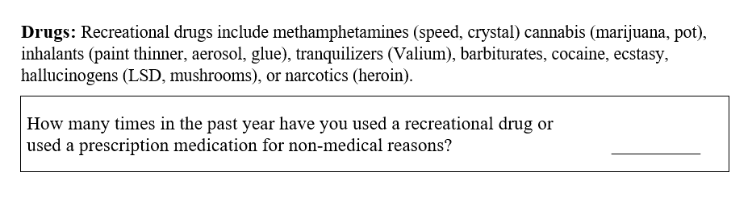
Single drug question
    Sens: 93% Spec: 94% for past year, self-reported drug use.
McNeely , et al. 2015
Notes:
This one-item drug question has good sensitivity and specificity for drug use, and easy to score. If a patient answers “1 or more” they qualify for a full drug screen.
Citation: McNeely J, Cleland CM, Strauss SM, Palamar JJ, Rotrosen J, Saitz R. Validation of Self-Administered Single-Item Screening Questions (SISQs) for Unhealthy Alcohol and Drug Use in Primary Care Patients. J Gen Intern Med. 2015 May 19.

Slide 42
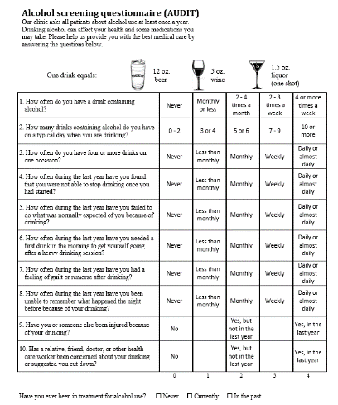
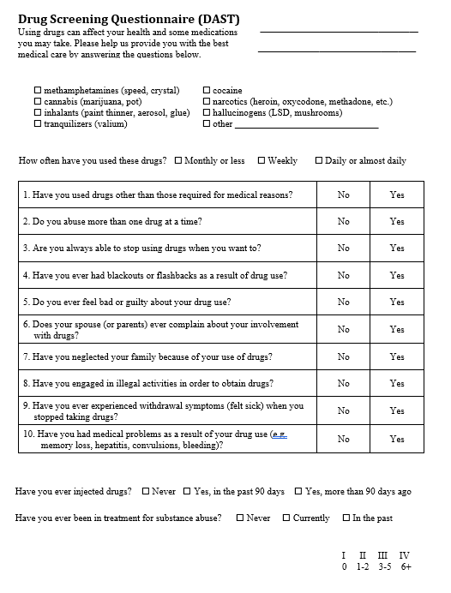
Full screens
AUDIT
DAST
Notes:
The purpose of the Full screen is to assess the severity of drug or alcohol use by categorizing patients who scored positive on the Brief screen into a Zone of use. Two commonly used validated questionnaires are the AUDIT and DAST.

Slide 43

Full screens in the emergency room
    Typically delivered via interview with behavioral health specialist
    When there’s a “break in the action” - waiting for x-rays, labs or ready for discharge
    Best case scenario: warm handoff
    Pts may be more receptive to BHS than medical clinician and answer more honestly than in triage
Notes:
The SBIRT workflow is different in an ED setting compared to primary care. The adult brief screen is often delivered verbally during triage, while the full screen, if indicated, is delivered on an opportunistic basis afterwards. Often, the medical clinicians are not involved in either the screening process or delivering brief interventions. Ideally, medical clinicians will introduce the patient to a behavioral health specialist through a warm handoff when a full screen is indicated.

Slide 44
AUDIT
    Alcohol Use Disorders Identification Test
    Created by WHO, accurate across many cultures/nations
    10 questions - multiple choice
    Addresses alcohol only
WHO, 2001
Notes:
The AUDIT is a widely used alcohol screening tool developed by the World Health Organization.
Citation: Thomas F. Babor, John C. Higgins-Biddle, John B. Saunders, Maristela G. MonteiroThe Alcohol Use Disorders Identification Test Guidelines for Use in Primary Care . World Health Organization, Department of Mental Health and Substance Dependence. 2001. http://whqlibdoc.who.int/hq/2001/who_msd_msb_01.6a.pdf

Slide 45
1. How often do you have a drink containing alcohol? | Never | Monthly or less | 2 - 4 times a month | 2 - 3 times a week | 4 or more times a week
2. How many drinks do you have on a typical day when drinking? | 1 or 2 | 3 or 4 | 5 or 6 | 7 to 9 | 10 or more
3. How often do you have four or more drinks on one occasion? | Never | Less than monthly | Monthly | Weekly | Daily or almost daily
4. How often during the last year have you found that you were not able to stop drinking once you had started? | Never | Less than monthly | Monthly | Weekly | Daily or almost daily
5. How often during the last year have you failed to do what was normally expected of you because of drinking? | Never | Less than monthly | Monthly | Weekly | Daily or almost daily
6. How often during the last year have you needed a first drink in the morning to get yourself going after a heavy drinking session? | Never | Less than monthly | Monthly | Weekly | Daily or almost daily
7. How often during the last year have you had a feeling of guilt or remorse after drinking? | Never | Less than monthly | Monthly | Weekly | Daily or almost daily
8. How often during the last year have you been unable to remember what happened the night before because of your drinking? | Never | Less than monthly | Monthly | Weekly | Daily or almost daily
9. Have you or someone else been injured because of your drinking? | No |  | Yes, but not in the last year |  | Yes, during the last year
10. Has a relative, friend, doctor, or other health care worker been concerned about your drinking or suggested you cut down? | No |  | Yes, but not in the last year |  | Yes, during the last year
 | 0 | 1 | 2 | 3 | 4
Notes:
This is how Clark filled out the AUDIT when given by Dr. Muench. Notice that the first three questions address quantity of drinking, which Clark would answer “4” to, since he drinks 10 beers a night. However, the rest of the questions deal with consequences from drinking. This is where Harmful and Severe drinkers are discerned from Risky drinkers. Clark, who lives alone and has few obligations, does not feel guilty about his drinking, and has never hurt himself or someone else (yet) from this drinking, answers “0” or “1” to these questions.

Slide 46
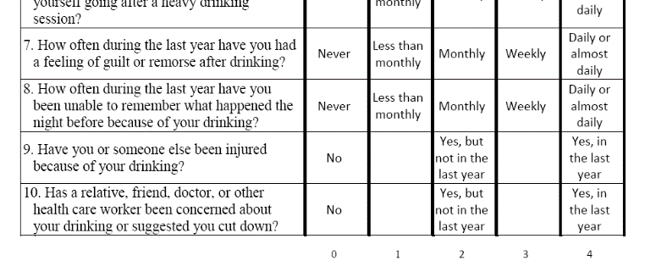
Scoring the AUDIT
    Each question has five answer choices
    Answers correlate with points, totaled for score
Notes:
Each answer on the AUDIT has a numerical value, and answers are added for a total score.

Slide 47
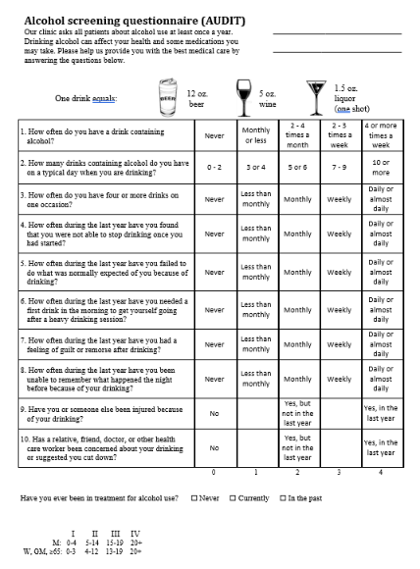
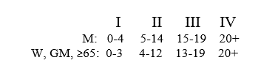

Circling the zone of use
Notes:
We added a table on the lower left of our AUDIT forms so that the clinician can easily score the AUDIT, while minimizing the chance that a patient does not bias their answers based on knowing what scoring category they may fall under. The Roman Numerals stand for the Zones of use, while the numbers are the limits that define each Zone. For example, if a male patient scores 18, they would score into Zone III: the Harmful Zone of use.

Slide 48
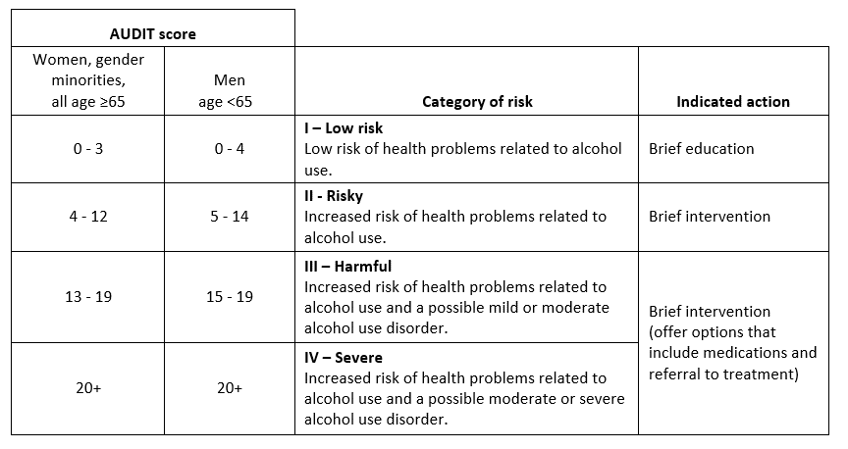
Suggested AUDIT zones and scores
Notes:
Note: many factors are involved in determining how much alcohol impacts an individual’s health. Determining the category of risk should be influenced by clinician judgment. The cut-off scores below are informed by validation studies, real-world experience of implementing the AUDIT into multiple primary care settings, and a gender-inclusive approach to patient care. However, they are offered for guidance only - clinics may choose different cut-off scores.
Citations:
Johnson J, Lee A, Vinson D, Seale P. “Use of AUDIT-Based Measures to Identify Unhealthy Alcohol Use and Alcohol Dependence in Primary Care: A Validation Study.” Alcohol Clin Exp Res, Vol 37, No S1, 2013: pp E253–E259
Flentje A, Barger BT, Capriotti MR, Lubensky ME, Tierney M, Obedin-Maliver J, et al. “Screening Gender Minority People for Harmful Alcohol Use.” PLoS ONE. 15(4). 2020.
Thomas F. Babor, John C. Higgins-Biddle, John B. Saunders, Maristela G. Monteiro. The Alcohol Use Disorders
Identification Test Guidelines for Use in Primary Care. 2nd Edition. World Health Organization. Department of Mental Health and Substance Dependence. 2001

Slide 49

Case study: Clark
    68yo male, never married, retired, lives alone
    Mild hypertension and diabetes since 2017, not obese
    Presents twice a year for follow up, usually no medical complaints
    Latest visit: discloses drinking 10 beers a night at local bar
Notes:
“Clark” (not his real name or picture) was a real patient who presented in a primary care clinic twice a year to follow up on his diabetes and hypertension.

Slide 50
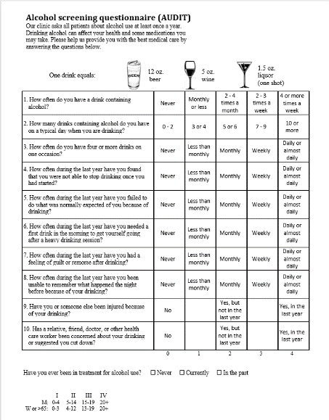

Exercise
    Take a minute to fill out an AUDIT, circling what you think might be Clark’s responses.
Notes:
In order to familiarize yourself with the AUDIT, take a moment to fill one out, guessing what Clark may answer if he was given the form. We don’t know much about Clark, other than he is retired and lives alone, drinks 70 beers a week, and has mild diabetes and hypertension.

Slide 51
Clark’s AUDIT answers:
Questions | 0 | 1 | 2 | 3 | 4
1. How often do you have a drink containing alcohol? | Never | Monthly or less | 2-4 times a month | 2-3 times a week | 4 or more times a week
2. How many drinks do you have on a typical day when drinking? | 1 or 2 | 3 or 4 | 5 or 6 | 7 to 9 | 10 or more
3. How often do you have four or more drinks on one occasion? | Never | Less than monthly | Monthly | Weekly | Daily or almost daily
4. How often during the last year have you found that you were not able to stop drinking once you had started? | Never | Less than monthly | Monthly | Weekly | Daily or almost daily
5. How often during the last year have you failed to do what was normally expected of you because of drinking? | Never | Less than monthly | Monthly | Weekly | Daily or almost daily
6. How often during the last year have you needed a first drink in the morning to get yourself going after a heavy drinking session? | Never | Less than monthly | Monthly | Weekly | Daily or almost daily
7. How often during the last year have you had a feeling of guilt or remorse after drinking? | Never | Less than monthly | Monthly | Weekly | Daily or almost daily
8. How often during the last year have you been unable to remember what happened the night before because of your drinking? | Never | Less than monthly | Monthly | Weekly | Daily or almost daily
9. Have you or someone else been injured because of your drinking? | No |  | Yes, but not in the last year |  | Yes, during the last year
10. Has a relative, friend, doctor, or other health care worker been concerned about your drinking or suggested you cut down? | No |  | Yes, but not in the last year |  | Yes, during the last year
Notes:
This is how Clark filled out the AUDIT when given by Dr. Muench. Notice that the first three questions address quantity of drinking, which Clark would answer “4” to, since he drinks 10 beers a night. However, the rest of the questions deal with consequences from drinking. This is where Harmful and Severe drinkers are discerned from Risky drinkers. Clark, who lives alone and has few obligations, does not feel guilty about his drinking, and has never hurt himself or someone else (yet) from this drinking, answers “0” or “1” to these questions.

Slide 52
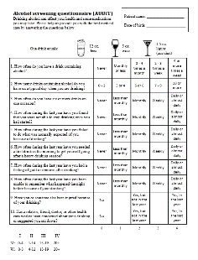
Clark’s AUDIT score: 15
Notes:
Adding up Clark’s answers, he places into the Risky Zone of use, almost into the harmful Zone. Clark is a bit of an outlier: most patients who drink 70 beers a week are dealing with consequences and would score higher. But because of Clark’s circumstances, his likely answers add up to 15. This means a brief intervention is the recommended action, rather than a referral to treatment, which many clinicians may have assumed with out the knowledge that the AUDIT provides.

Slide 53
Full screen: DAST
    Drug Abuse Screening Test
    DAST-10 version
    Validated for adults
    Cut-off score of 3 has high validity for drug “abuse”
Skinner, 1982. Yudko 2007.
Notes:
The DAST is a ten-item screen designed for drugs use only with high sensitivity and specificity towards drug use.
Citations: Skinner, H. A. (1982). The Drug Abuse Screening Test. Addictive Behaviors, 7, 363-371. http://www.ncbi.nlm.nih.gov/pubmed/7183189
Yudko E, Lozhkina O, Fouts A. A comprehensive review of the psychometric properties of the Drug Abuse Screening Test. Journal of Substance Abuse Treatment 32 (2007) 189 – 198. http://www.ncbi.nlm.nih.gov/pubmed/17306727

Slide 54
1. Have you used drugs other than those required for medical reasons? | No | Yes
2. Do you abuse more than one drug at a time? | No | Yes
3. Are you always able to stop using drugs when you want to? | No | Yes
4. Have you ever had blackouts or flashbacks as a result of drug use? | No | Yes
5. Do you ever feel bad or guilty about your drug use? | No | Yes
6. Does your spouse (or parents) ever complain about your involvement with drugs? | No | Yes
7. Have you neglected your family because of your use of drugs? | No | Yes
8. Have you engaged in illegal activities in order to obtain drugs? | No | Yes
9. Have you ever experienced withdrawal symptoms (felt sick) when you stopped taking drugs? | No | Yes
10. Have you had medical problems as a result of your drug use (e.g. memory loss, hepatitis, convulsions, bleeding)? | No | Yes
Notes:
The DAST is a ten-item screen designed for drugs use only with high sensitivity and specificity towards drug use.
Citations: Skinner, H. A. (1982). The Drug Abuse Screening Test. Addictive Behaviors, 7, 363-371. http://www.ncbi.nlm.nih.gov/pubmed/7183189
Yudko E, Lozhkina O, Fouts A. A comprehensive review of the psychometric properties of the Drug Abuse Screening Test. Journal of Substance Abuse Treatment 32 (2007) 189 – 198. http://www.ncbi.nlm.nih.gov/pubmed/17306727

Slide 55
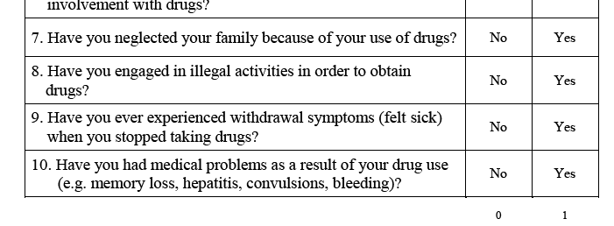
Scoring the DAST
    Each question has yes or no answer
    Yes answers get one point
Notes:
Like the AUDIT, the DAST assigns numerical values to each answer choice – a “no” gets zero points and a “yes” gets one point. Points are added for a total score.

Slide 56
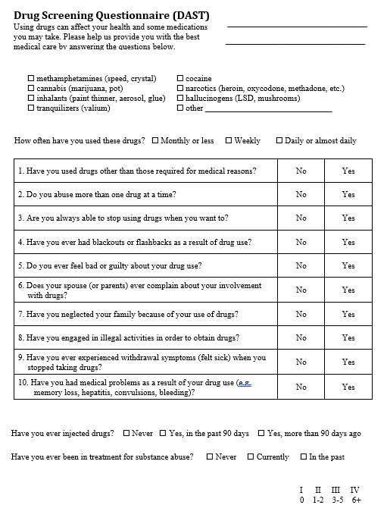
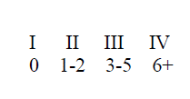
Circling the zone of use
Notes:
Like the AUDIT, the same scoring table is featured on the bottom right of our forms. The clinician can quickly score the questionnaire and circle the Zone of use.

Slide 57
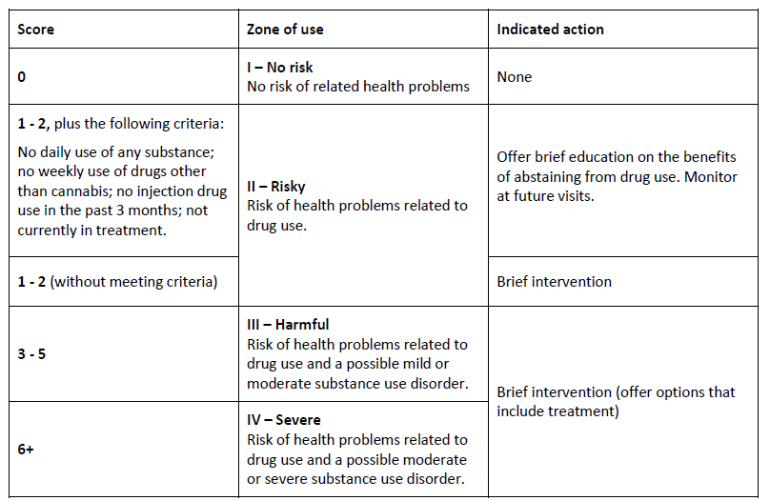
Scoring the DAST
Notes:
Answering “Yes” to any question on the DAST puts a patient at least into the Risky zone. Notice there is no difference in scoring based on gender.

Slide 58
Extra questions added to the DAST
    Types of drugs used
    Frequency of use
    Injection drug use
    Status of drug treatment
www.sbirtoregon.org
Notes:
While the DAST is useful in medical settings, the version available for download on the sbirtoregon.org website includes extra questions that provide important information to the clinician and behavioral health specialist.

Slide 59
Drawbacks of the DAST
    Includes the outdated and ambiguous word, “abuse”
    The word “neglect” may be triggering and not seen as trauma-informed
    Doesn’t ask about consequences and different types of drugs
www.sbirtoregon.org
Notes:
While the DAST is useful in medical settings, the version available for download on the sbirtoregon.org website includes extra questions that provide important information to the clinician and behavioral health specialist.

Slide 60
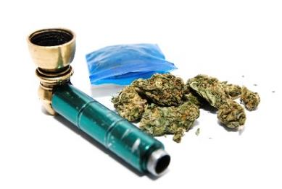
DAST and Cannabis
    Brief intervention may not be necessary when:
      No daily use of any substance
      No weekly use of opioids, cocaine, or meth
      No injection drug use in the past 3 months.
      Not currently in treatment.
Notes:
When patients score into the Risky zone of drug use, but also meet these criteria, it is not necessary that a full brief intervention be delivered. Providing information with monitoring at future visits is sufficient.

Slide 61
Limits of available drug screening tools
Validated tool | Asks about specific drugs? | Asks about frequency of use? | Asks about consequences? | Valid for identifying disorder? | Feasible for use in primary care? | Drawbacks
DAST 10 | No (unless added) | No (unless added) | Yes | Yes | Yes | Includes the outdated word “abuse”. The word “neglect” can also be seen as triggering and not trauma-informed.
ASSIST | Yes | Yes | Yes | Yes | No | Too long and too many skip patterns to be practical in primary care, unless in an electronic format.
TAPS | Yes | No | Yes | Yes | Yes | Includes alcohol, so is redundant with use of AUDIT. Excludes gender minorities.
SUBS | Only “any illegal drug” and Rx meds | No | No | Yes | Yes | A brief screen. Includes alcohol, so is redundant with use of AUDIT.
CAGE | No | No | Yes | Yes | Yes | Includes alcohol, so is redundant with use of AUDIT.
Notes:
While the DAST is useful in medical settings, the version available for download on the sbirtoregon.org website includes extra questions that provide important information to the clinician and behavioral health specialist.

Slide 62

Case study: Stacey
    30yo female, single, works at restaurant, lives with housemate
    Takes Aderall for ADHD past two years
    Presents every few months for in-person follow up, usually no medical complaints.
    Uses a “bump” of cocaine most weekends
Notes:
“Stacey” is a hypothetical patient who takes Aderall and uses cocaine on weekends.

Slide 63
Exercise:
    Take a minute to fill out a DAST, circling what you think might be Stacey’s responses.
Notes:
In order to familiarize yourself with the DAST, take a moment to fill one out, guessing what Stacey might answer if she was given the form.

Slide 64
x
x
Stacey’s possible DAST answers
x
x
Notes:
Stacey likely falls into Zone 2 and should receive a brief intervention about her cocaine use.

Slide 65
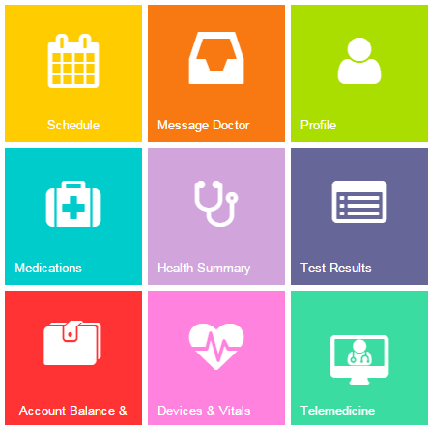
Screening via patient portal
      Pros:
        Can be completed before visit
        Questions answered without conversation with clinician
      Cons:
        Results may get lost in EHR
        Can’t ensure pt privacy
        Proxy accounts for younger teens break confidentiality
Notes:
Image: Free google image

Slide 66
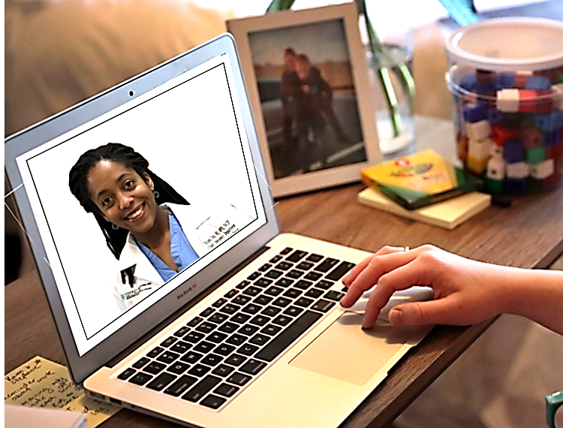
Screening via online interview
      Pros:
        Can clarify questions in real time
        Results entered in EHR immediately
        An opportunity to build rapport, set the stage for BI
      Cons:
        Takes up time during visit
        Pt has to answer questions directly to clinician
Notes:
Image: Free google image

Slide 67
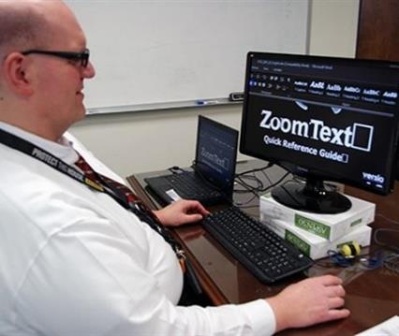

Tips on screening via online interview
        Try to confirm that pt is in private space and can't be overheard
        Can be done during any portion of the visit
        Explain reason behind screening
        Raise the subject and ask permission
        Read validated questions as written
Notes:
Image: Free google image

Slide 68
Reimbursement and EHR tools

Slide 69
Screening-only billing codes
Service | Payer | Code | Description
Screening only | Medicaid | CPT 96160 | Administration and interpretation of a health risk assessment instrument.
 | Medicare | G0442 | Screening for alcohol misuse in adults once per year.
Codes above should be appended to E/M service with modifier 25
ICD-10 diagnosis codes are poorly suited for most SBIRT patient scenarios and can break confidentiality. Two options:
    Z13.89: “Encounter for screening for other disorder”
    Z13.9: “Encounter for screening, unspecified”
Notes:
SBIRT processes are reimbursable, and play an important role as data elements that count towards the CCO SBIRT incentive measure in Oregon. The 99406 is the most commonly used code. It is advisable to consult with a billing specialist to learn more about use of these codes.

Slide 70
Screening + BI codes
Service | Payer | Code | Description
Full screen + brief intervention | Medicare | G2011 | 5-14 minutes of aggregate clinic time spent administrating and interpreting a validated alcohol or drug screening tool, plus performing a face-to-face brief intervention the same day.
Full screen + brief intervention | Medicaid | CPT 99408 | Same as above, 15 – 29 minutes.
 | Medicare | G0396
 | Medicaid | CPT 99409 | Same as above, ≥ 30 minutes.
 | Medicare | G0397
Codes above should be appended to E/M service with modifier 25
ICD-10 diagnosis codes are poorly suited for most SBIRT patient scenarios and can break confidentiality. Two options:
    Z13.89: “Encounter for screening for other disorder”
    Z13.9: “Encounter for screening, unspecified”
Notes:
Unfortunately, the billing codes that account for brief interventions require at least 15 minutes be spent administrating and interpreting a full screen, plus performing a brief intervention. As a result, these codes are rarely billed by medical providers.
Citation: SBIRT Guidance Document. Oregon Health Plan Version 5 – Revised December 2014

Slide 71
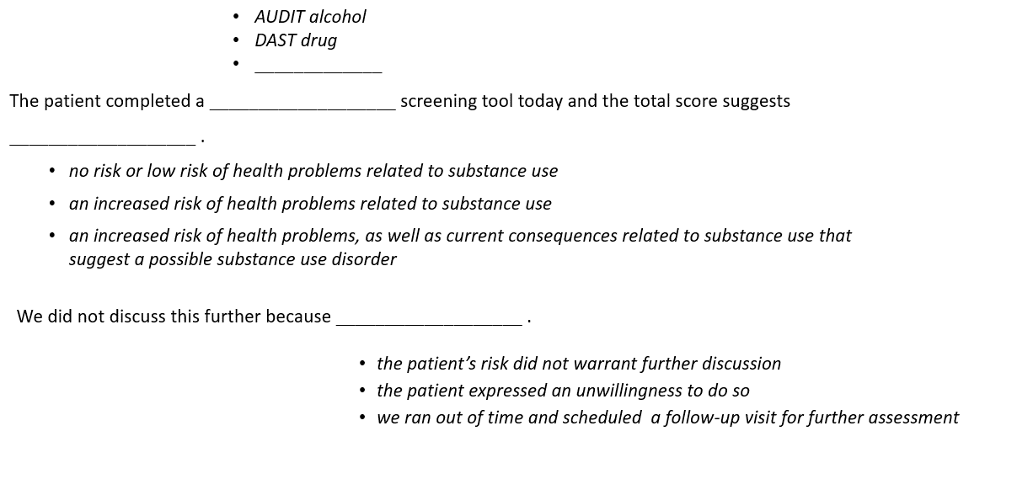
Documentation supporting screening-only with adult pts (CPT 96160)
www.sbirtoregon.org
Notes:
Above is an example of a progress note that sufficiently supports use of the CPT 96160 billing code when an AUDIT or DAST is negative and no brief intervention is indicated. This language may be incorporated into a Smart Phrases tool in the electronic medical record.
Citation: http://www.sbirtoregon.org/documentation.php

Slide 72
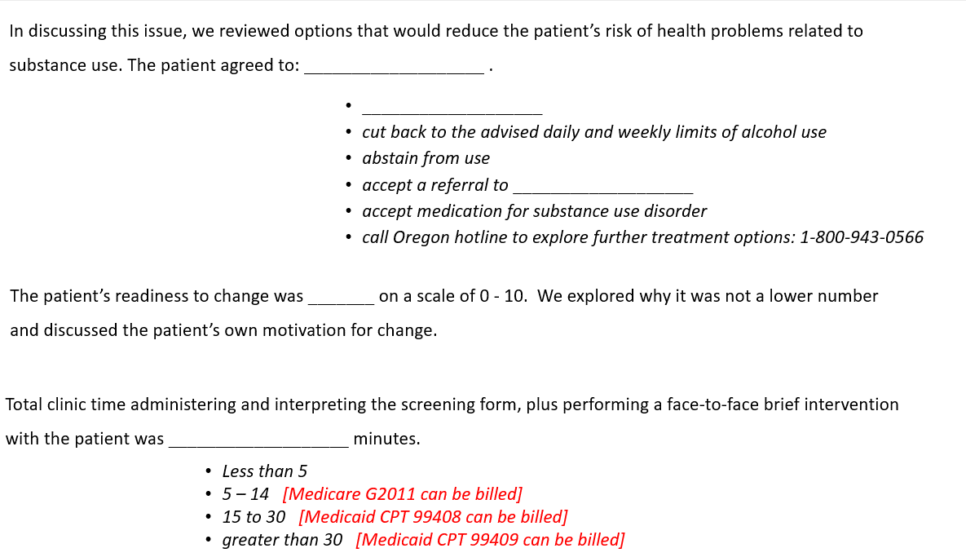
Documentation supporting SBI with adults
www.sbirtoregon.org
Notes:
Above is an example of a progress note that sufficiently supports use of the CPT 99408 billing code when an AUDIT or DAST is positive and a brief intervention is performed. This language may be incorporated into a Smart Phrases tool in the electronic medical record.
Citation: http://www.sbirtoregon.org/documentation.php

Slide 73
Who’s allowed to independently bill for SBI
Oregon Medicaid | Medicare
Physicians (MD, DO, ND) | Physicians (MD, DO)
Physician Assistants | Physician Assistants
Nurse Practicioners | Nurse Practicioners
Licensed Clinical Psychologists | Licensed Clinical Psychologists
Licesned Clinical Social Workers | Licesned Clinical Social Workers
Licensed Professional Counselors | Certified Nurse Midwives
Licensed Marriage and Family Therapists | Clinical Nurse Specialists
Notes:
Only the following licensed professionals are allowed to bill SBIRT codes independently.
Citation: SBIRT Guidance Document. Oregon Health Plan Version 5 – Revised December 2014

Slide 74

Incident-to billing
    Any clinic employee under supervision can bill for SBI. Examples:
      CADCs, Health Educators, Registered Nurses, Clinical Nurse Specialist, Students or Graduates entering medical profession, Community Health Workers
      Some limitations apply to certain clinic settings
OHA, 2014
Notes:
For Oregon Medicaid, any clinic employee or contractor acting under the supervision of a licensed and credentialed provider may be able to receive reimbursement for screening and brief intervention services, under incident-to rules.
Citation: SBIRT Guidance Document. Oregon Health Plan Version 5 – Revised December 2014

Slide 75
Oregon CCO metric: SBIRT
RATE 1:
RATE 2:
Patients with either a negative brief screen or a full screen.
Pts who received a brief intervention, or referral to treatment within 48 hours
Pts ≥12 years visit in last year
Pts with a positive full screen.
OHA

Slide 76
Oregon CCO metric: IET
Initiation and Engagement of Alcohol and Other Drug Abuse or Dependence Treatment
Initiation rate:
Engagement rate:
Pts who received AOD Treatment within 14 days
Pts who received 1 or 2 AOD treatments within 34 days of initiating treatment
Pts ≥13 years with a new AOD dx
Pts ≥13 years with a new AOD dx
  A brief intervention with a BHS counts as satisfying the numerator in both rates
OHA

Slide 77
Brief intervention

Slide 78
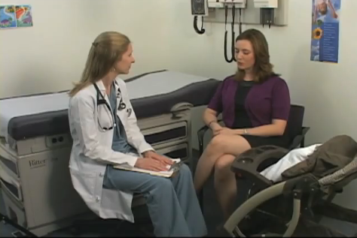
Video:
The Ineffective Clinician
https://www.youtube.com/watch?v=cSBsgmgYm8o
University of Florida, Psychiatry Dept.
Notes:
One way to introduce the guiding style of communication is to contrast it with a directive style, which is demonstrated in this video from the University of Florida. Afterwards: What did the physician specifically do that increased the person’s level of resistance to change?
Video: http://www.youtube.com/watch?v=2fdfzUS1qDc

Slide 79
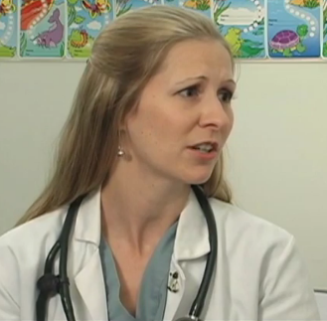
Characteristics of a directive style of communication
    Explaining why the pt should change
    Telling how the pt should change
    Emphasizing how important it is to change
    Trying to persuade the pt to change
Rollnick and Miller, 2008
Notes:
Do you: Explain what patients could do differently in the interest of their health? Advise and persuade them to change their behavior? Counsel them about how to change their behavior? The directive style usually doesn’t work when addressing behavior change, because most people are ambivalent about making “behavior/lifestyle” changes. They often both want to make the change and don’t want to make the change. Motivational Interviewing is based in part on Bem’s self-perception theory which states, “that which I say I believe.” So a person who spends 5 minutes during a visit telling you all the reasons he or she cannot make the change, in response to your best persuasion efforts, is more likely to continue with the status quo than someone who has been encouraged through a guiding style of conversation to identify their own reasons and possible solutions for making a change.

Slide 80
Common patient reactions to the directive style
Angry | Afraid
Agitated | Helpless, overwhelmed
Oppositional | Ashamed
Discounting | Trapped
Defensive | Disengaged
Justifying | Not come back – avoid
Not understood | Uncomfortable
Procrastinate | Not heard
Rollnick and Miller, 2008
Notes:
These are adjectives patients report feeling when confronted with a directive style of communication towards their own behavior. Not only are they less like to change behavior, but they are less likely to come back for follow up.

Slide 81
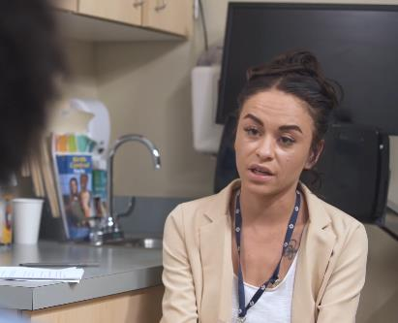
Characteristics of helpful brief interventions
    Be a listening guide, rather than an expert director
    Honor the patient’s autonomy, own goals and values
    Be comfortable with pt’s ambivalence
    Recognize pts own expertise
    Express compassion and empathy
    Foster hope
Notes:
The guiding style seems particularly suited to difficult conversations about behavior change. Motivational Interviewing is a refined style of guiding. Brief Motivational interventions are structured to focus on the patient’s perspective of the problem, and what if anything the patient wants to do about it. “Health care emphasizes human autonomy, the right of the person to make informed decisions about the course of his or her own life. Letting go of control does not mean lack of influence. Special attention is focused on understanding the perspective of the patient and where they are in the change process. Ambivalence– emphasizing how normal ambivalence is… think about the last significant behavior change you made in your life, part of the conversation is designed for patients to explore their own ambivalence. Key distinction is to keep in mind the patient is the expert, you may be the health care expert, but the patient is the expert on how their life and how they might go about making a change.
Key is to remain neutral and non-judgmental.

Slide 82
Some reasons people use substances
    Escape from stress
    Avoid withdrawal
    Escape from grief
    Enjoyment of feeling high
    Peer pressure
    Enhance performance
    To fit in
    To experiment
    Escape from negative thoughts
    To relax
    Career pressures
    Escape feelings of loneliness
    To deal with boredom
    Instant gratification
    Not ready to quit
    Feeling of control
    Family demands

Slide 83
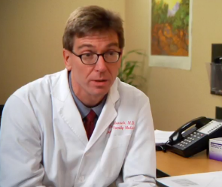
Brief Interventions in medical settings
    Should employ motivational interviewing (evidence-based)
    Even three minutes can have effect
    Can be performed by any trained clinic employee
    2 hours of training can make difference
Humeniuk et al, 2010. Cunningham et al, 2014. Whitlock et al, 2004.
Notes:
Clinicians can deliver a brief intervention in 3-5 minutes and have a significant impact on improving the health of their patients. Not much is yet known which component of the brief intervention is most effective, but evidence suggests providing the patient with feedback specific to their alcohol use may be most important. Brief interventions can be delivered by providers, behavioral health specialists, health educators – anyone with appropriate training. It is not necessary to be an expert in motivational interviewing – just 2 hours of training time has been shown to be enough to deliver effective brief interventions.
Citations: Humeniuk S, Henry-Edwards A, Poznyak V, Monteiro M. The ASSIST-linked brief intervention for hazardous and harmful substance use Manual for use in primary care. World Health Organization 2010
Cunningham JA, Murphy M, Hendershot CS. Treatment dismantling pilot study to identify the active ingredients in personalized feedback interventions for hazardous alcohol use: randomized controlled trial. Addiction Science & Clinical Practice 2014. http://www.ascpjournal.org/content/10/1/1
Whitlock EP, Green CA, Polen MR. Behavioral Counseling Interventions in Primary Care to Reduce Risky/Harmful Alcohol Use. Systematic Evidence Reviews, No. 30. Agency for Healthcare Research and Quality (US); 2004 Mar. http://www.ncbi.nlm.nih.gov/pubmedhealth/PMH0007770/

Slide 84

What intervention skills are most effective?
    Results of 70 years of psychotherapy research:
    Empathy
    Positive regard
    Genuineness
    Accpetance
    Focus
    Hope
    Evocation
    Offering information and advice
Miller and Moyers, 2021
Notes:
Clinicians can deliver a brief intervention in 3-5 minutes and have a significant impact on improving the health of their patients. Not much is yet known which component of the brief intervention is most effective, but evidence suggests providing the patient with feedback specific to their alcohol use may be most important. Brief interventions can be delivered by providers, behavioral health specialists, health educators – anyone with appropriate training. It is not necessary to be an expert in motivational interviewing – just 2 hours of training time has been shown to be enough to deliver effective brief interventions.
Citations: Humeniuk S, Henry-Edwards A, Poznyak V, Monteiro M. The ASSIST-linked brief intervention for hazardous and harmful substance use Manual for use in primary care. World Health Organization 2010
Cunningham JA, Murphy M, Hendershot CS. Treatment dismantling pilot study to identify the active ingredients in personalized feedback interventions for hazardous alcohol use: randomized controlled trial. Addiction Science & Clinical Practice 2014. http://www.ascpjournal.org/content/10/1/1
Whitlock EP, Green CA, Polen MR. Behavioral Counseling Interventions in Primary Care to Reduce Risky/Harmful Alcohol Use. Systematic Evidence Reviews, No. 30. Agency for Healthcare Research and Quality (US); 2004 Mar. http://www.ncbi.nlm.nih.gov/pubmedhealth/PMH0007770/

Slide 85
Textbook definition of motivational interviewing
    A person-centered counseling style for addressing the common problem of ambivalence about change.
  Miller and Rollnick, 2012.
Notes:
Motivational Interviewing in Health Care: Helping Patients Change Behavior (2008) Stephen Rollnick, William Miller, Christopher Butler

Slide 86

Two central goals of MI
    “To create and amplify, from the client’s perspective, a discrepancy between present behavior and broader goals and values.”
    “To evoke statements indicating reasons for, desire to, or intent to change (change talk)”
Lozano, et al, 2010
Notes:
Lozano P, McPhillips HA, Hartzler B, et al. Randomized Trial of Teaching Brief Motivational Interviewing to Pediatric Trainees to Promote Healthy Behaviors in Families. Arch Pediatr Adolesc Med.2010;164(6):561-566. doi:10.1001/archpediatrics.2010.86.

Slide 87

How MI works
    Eliciting and affirming change talk helps pts move towards resolving ambivalence
    People become more committed towards change when they hear themselves give voice to change
    Respect, collaboration and empathy create conditions for change to occur
Notes:
Lozano P, McPhillips HA, Hartzler B, et al. Randomized Trial of Teaching Brief Motivational Interviewing to Pediatric Trainees to Promote Healthy Behaviors in Families. Arch Pediatr Adolesc Med.2010;164(6):561-566. doi:10.1001/archpediatrics.2010.86.

Slide 88
Steps of the brief intervention
Raise subject
Share information
Enhance motivation
Identify plan
Notes:
There are several models of brief variations but for the most part they all contain the same essential elements. This BI model is an adaptation of Motivational Interviewing and adheres to the spirit and principles of MI.
Citation: The Yale Brief Negotiated Interview Manual (2005) Gail D`Onofrio, Michael V. Pantalon, Linda C. Degutis, David Fiellin, Patrick G. O’Connor, Yale University School of Medicine

Slide 89
Steps of the brief intervention
  Ask permission to discuss patient’s substance use
  Convey transparency about your role
Raise subject

Slide 90
Transparency example
Thank you for giving me permission to discuss your substance use with you. Just so you know, I will not ask or advise you to stop or change your use in any way you do not want to. Instead, my focus is to understand what your goals or visions for your future are. I can share information with you so you can improve your quality of life on your own terms and on your own timeline.
How does that sound to you?
HaRRT Center

Slide 91
Steps of the brief intervention
  Ask permission to discuss patient’s substance use
  Convey transparency about your role
  Ask the patient to describe their use
Raise subject

Slide 92
Steps of the brief intervention
  Share info about:
    The pt’s score on the screening tool
    Any association between use and health complaint
    General risks of use
  Ask pt what they think about the information shared
Share information

Slide 93

Pitfalls of giving advice or recommendations
    Implies judgement, risks furthering stigma
    Clinician-driven rather than patient-driven
    Patients with SUDs may already feel trapped
    Giving advice is different than brainstorming options

Slide 94
Steps of the brief intervention
  Elicit and summarize pros and cons
    - What pt likes and doesn’t like about their use
Enhance motivation

Slide 95
Pros and cons example
“So on one hand, I hear you say that your cannabis use makes you feel relaxed after a day of work, and it reduces your anxiety in the short term. On the other hand, you wonder sometimes if you’re becoming addicted to cannabis, and you don’t like it when your partner nags you about smoking pot. Is that correct?”
HaRRT Center

Slide 96
Steps of the brief intervention
  Elicit and summarize pros and cons
    - What pt likes and doesn’t like about their use
  Elicit goal(s)
    - What change the pt would like to see
Enhance motivation

Slide 97

Questions that elicit patient goals
  “Over the next few (weeks, months) what would you like to see happen for yourself?”
  “What would you like to do about your use?”
  “Where would you like to go with your drinking/drug use?”

Slide 98

Goals are more achievable when they are:
Well defined
Focused on reducing harm or improving quality of life
Doable in a timeframe
Patient-driven
HaRRT Center
Notes:
Image: google free

Slide 99
Helping pts with abstract, or large goals
??
??
??
Living healthier
Patient: “I want to live healthier.”
Clinician: “That’s a great goal. It’s also a big goal. So, let’s put that up here on the top step. What could be the first step towards living healthier?”
Slide: HaRRT Center

Slide 100

Some examples of pt-driven goals: alcohol
    Reducing or abstaining
    Counting drinks
    Eating before drinking, and during
    Spacing drinks
    Accepting meds for AUD or other treatment
    Avoid mixing drugs with alcohol
    Drinking in a safe place
    Choosing periodic abstinence
    Choosing lower-alcohol content beverages

Slide 101

Some examples of pt-driven goals: drugs
    Injecting more safely
    Minimizing sharing works or needles
    Carrying Naloxone
    Using less
    Accept MOUD or other treatment
    Learning abscess care
    Getting more regular medical care and/or mental health care

Slide 102
Steps of the brief intervention
  Elicit and summarize pros and cons
    - What pt likes and doesn’t like about their use
  Elicit goal(s)
    - What change the pt would like to see
  Gauge confidence to achieve goal
  - Use readiness ruler
Enhance motivation

Slide 103

Readiness Ruler
  “On a scale of 0 to 10, how confident are you to achieve your goal?”
  “Why do you think you didn’t pick a lower number?”
  Gauges level of motivation
  Answering the follow up question enhances existing motivation

Slide 104
Steps of the brief intervention
  If patient sounds ready, ask: “What would a plan of reaching your goal look like for you?”
  Affirm pt’s readiness to change
  Ask to schedule follow-up
Identify plan

Slide 105

Follow up
  A continuing cycle of:
  Collaborative tracking of patient-selected goals
  Sharing information about risks
  Eliciting new pt-driven harm reduction goals
HaRRT Center

Slide 106
Remember:
Defer to the patient’s wisdom
The more responsibility, autonomy and respect people feel they have, the more they will step up and forge their own pathway.
HaRRT Center

Slide 107
Raise the
subject
“Thanks for filling out this form – is it okay if we briefly talk about your substance use?”
“My role is to help you assess the risks so you can make your own decisions. I want to help you improve your quality of life on your own timeline.”
“What can you tell me about your substance use?”
Share
information
Explain any association between the patient’s use and their health complaint, then ask, “Do you think your use has anything to do with your [anxiety, insomnia,, etc,]?”
Share information about the risks of using alcohol, drugs, and misusing prescription drugs. Ask the patient: “What do you think of this information?”
Enhance motivation
Ask pt about perceived pros and cons of their use, then summarize what you heard.
“Where do you want to go from here in terms of your use? What’s your goal or vision?
Gauge patient’s readiness/confidence to reach their goal. If using Readiness Ruler: “Why do did you pick ___ on a scale of 0-10 instead of ____ [lower number]?”
Identify
plan
If patient is ready, ask: “What steps do you think you can take to reach your goal?”
Affirm the patient’s readiness/confidence to meet their goal and affirm their plan.
“Can we schedule an appointment to check in and see how your plan is going?”

Slide 108


  Adult reference sheet
  (front & back)
Available at sbirtoregon.org
Notes:
Handout: Reference sheets
When performing a brief intervention, tools like these reference sheets, which can be downloaded from the sbirtoregon website, can be helpful. The front of these sheets are designed for display to patients, while back acts as reference for clinicians and behavioral health specialists. A single copy can be laminated and stocked in each exam room or back office.

Slide 109




Patient handouts
    Download at sbirtoregon.org
    English and Spanish
    Separate handouts based on substance and population
    Should reinforce, not replace brief interventions
www.sbirtoregon.org

Slide 110

Bias and delivery of BI
    Study of 287,551 adult patients screening positive for unhealthy alcohol use:
      Women less likely to receive BI, particularly during middle age.
      Black women and Latina/Hispanic women less likely to receive BI than women in other race/ethnicity groups.
      Receipt of BI does not appear to differ by drinking levels between men and women.
Parthasarathy et al, 2023
Notes:
Parthasarathy S, Chi FW, Metz V, Kline-Simon A, Asyyed A, Campbell CI, Sterling S. Disparities in the receipt of alcohol brief intervention: The intersectionality of sex, age, and race/ethnicity. Addiction. 2023 Jul;118(7):1258-1269. doi: 10.1111/add.16195. Epub 2023 Apr 11. PMID: 36988614.

Slide 111

Warm introduction principles
    In-person introduction to behavioral health specialist
    Refer to as “colleague” or “specialist”
    Brief intervention delivered during same visit
    Avoid “counseling” label
Notes:
Warm handoffs confer trust and rapport the client has developed with the provider to the behavioral health specialist when done correctly. The primary care clinician should directly introduce the pt to the behavioral health specialist at the time of the pt’s medical visit. Ideally, the behavioral health specialist offers a complete brief intervention or referral at the time of the hand-off. The primary care clinician should use the same content or tone as a referral to any other specialist. Patients can sense the importance a provider implies and respond accordingly. “Colleague” or “someone who specializes in” are terms less likely to invoke stigma than “counselor,” or “therapist” or ‘social worker.” Asking or offering a patient “counseling” is less effective than offering them education or ideas or even support.
Citation: Integrated Behavioral Health Project (IBHP). California Mental Health Services Authority.
“Warm Hand-Off Referrals By the Primary Care Provider To the Behaviorist” http://www.ibhp.org/index.php?section=pages&cid=122

Slide 112

Case study: “Barbara”
    60-year old female visiting a new PCP to discuss her anti-depression meds
    Drinks 4x a week, 3-4 glasses of wine per occasion
    Lives alone
    Completed the AUDIT and scored 14
Notes:
Handout: Jill role play
Learning how to perform brief interventions with patients takes practice. Take a moment to get into groups of three, choose which role to play for the “Jill” case study, read your part, and get started.

Slide 113



Practice: “Barbara”
    Groups of three:
    Clinician
    Patient
    Observer
Notes:
Handout: Jill role play
Learning how to perform brief interventions with patients takes practice. Take a moment to get into groups of three, choose which role to play for the “Jill” case study, read your part, and get started.

Slide 114

Video demonstration: “Barbara”
https://www.youtube.com/watch?v=PaSKcfTmFEk
Notes:
Handout: Jill role play
Learning how to perform brief interventions with patients takes practice. Take a moment to get into groups of three, choose which role to play for the “Jill” case study, read your part, and get started.

Slide 115

Case study: “Miguel”
    35-year old presenting for a telehealth visit
    Complains of migraines
    Injects heroin 2-3 days per week
    Completed the DAST and scored 4
Notes:
Handout: Jill role play
Learning how to perform brief interventions with patients takes practice. Take a moment to get into groups of three, choose which role to play for the “Jill” case study, read your part, and get started.

Slide 116
Practice: “Miguel”
    Groups of three:
    Clinician
    Patient
    Observer
Notes:
Handout: Jill role play
Learning how to perform brief interventions with patients takes practice. Take a moment to get into groups of three, choose which role to play for the “Jill” case study, read your part, and get started.

Slide 117

Video demonstration: “Miguel”
https://www.youtube.com/watch?v=7nevSz5-dhc
Notes:
Handout: Jill role play
Learning how to perform brief interventions with patients takes practice. Take a moment to get into groups of three, choose which role to play for the “Jill” case study, read your part, and get started.

Slide 118

Stages of change
Pre-
contemplation
Return to
use
Contemplation
Maintenance
Preparation
Action
Notes:
How many of you are familiar with the stages of change model? When we describe the spectrum of patient responses to hearing a recommendation of changing their substance use, the Stage of Change model is frequently cited. People typically move through these stages in order before they reach Action. The goal of the brief intervention is to help patients move to the next stage. “Behavior change is a rarely a discrete single event. During the past decade, behavior change has come to be understood as a process of identifiable stages through which patients pass. Physicians can enhance those stages by employing motivational interviewing.

Slide 119

OARS skills
    Open-ended questions
    Affirmations
    Reflective listening
    Summaries

Slide 120

Open-ended questions
    Invites the patient to “tell their story” without leading them in a specific direction
    Should be used often, but not exclusively
    Important to listen to the person’s response

Slide 121
Examples of open-ended questions
Closed | Open
Are you in pain?
How often do you use drugs?
Don’t you want to stop using and be sober?
How do you feel?
What role do drugs play in your life?
What advantages do you see in changing your drug use?

Slide 122

Affirmations
    Statements that recognize patient strengths
    Acknowledging positive behaviors, no matter how big or small
    Help build confidence and self-efficacy
    Must be genuine

Slide 123
Examples of affirmations
You really care a lot about your health
This is hard work you’re doing
You were successful in changing in the past
That’s a good idea
You are clearly very resourceful
I appreciate that you are willing to talk honestly with me about this

Slide 124

Reflective listening
    Understanding what your patient is thinking and feeling, and then saying it back to the patient
    Engages your patient, conveys empathy, builds trust, and fosters motivation to change
    Allows you to see the world through your patient’s eyes

Slide 125
Examples of reflective listening
Patient: | Clinician:
I don’t think I’m really addicted to heroin.
I’ve never not used drugs – I think it’s just who I am.
I don’t like being fired from my job
I know I shouldn’t shoot up – but I haven’t stopped yet. | .
Being told you may have a substance use disorder doesn’t seem right to you.
Using drugs feels normal to you.
Being able to keep a job is important to you.
You know all the reasons to not inject drugs, but it’s been hard to find the motivation to stop

Slide 126

Summarizing
    Special applications of reflective listening
    Particularly helpful at transition points, or when you’re not sure what to say next
    Good way to help patient analyze pros and cons

Slide 127
Summarizing example
I don’t want to go to treatment
I’m worried about withdrawal
My kids might support me
Patient
I’d have to find transportation
I’d feel safer if I got help

Slide 128
Summarizing example
“If I hear you right, it sounds like you’re not interested in treatment right now. There’s a challenge in that you’d have to find transportation and you’re worried about going through withdrawal. But you also think it would be safer in the long run and your relationship with your children might improve.”
Clinician

Slide 129
Referral to Treatment
Notes:
Referrals to treatment are appropriate when a patient is likely experiencing a moderate or severe substance use disorder, and is willing to get help from a specialist.

Slide 130

Addiction Medicine training
    Most U.S. medical schools and residency programs do not provide a full set of training for treating addiction
    About half of U.S. medical schools provide teaching sessions during clinical years in the treatment of SUDs
    About 15% of residency and fellowship programs have “experiential training” using MOUD
NYT, 2023
Notes:
“Addiction can be treated. Doctors need to learn how” https://www.washingtonpost.com/opinions/2023/06/13/doctors-medical-school-addiction-buprenorphine/

Slide 131

SUDs in the Past Year: People Aged 12 or Older; 2020
SAMHSA, 2021
Notes:
Citation:https://www.samhsa.gov/data/sites/default/files/reports/rpt35325/NSDUHFFRPDFWHTMLFiles2020/2020NSDUHFFR1PDFW102121.pdf

Slide 132
Study of patients with SUDs
 | Any SUD % | Alcohol Use Disorders % | Cannabis Use Disorders % | Opioid Use Disorders %
Alcohol | 57.6 | - | 32.3 | 21.6
Cannabis | 14.9 | 8.3 | - | 12.5
Opioid | 12.5 | 4.7 | 10.5 | -
Amphetamine | 5.8 | 3.4 | 9.3 | 6.2
Cocaine | 3.5 | 3.2 | 6.2 | 3.9
Barbiturate | 2.1 | 1.6 | 2.9 | 9.5
Hallucinogen | 0.2 | 0.1 | 0.8 | 0.3
45,461 patients diagnosed with SUDs at Kaiser Permanente Northern California health care system
NIDA, 2017
Notes:
NIDA. 2017, October 24. Substance Use Disorders Are Associated With Major Medical Illnesses and Mortality Risk in a Large Integrated Health Care System. Retrieved 2020, September 8. https://www.drugabuse.gov/news-events/nida-notes/2017/10/substance-use-disorders-are-associated-major-medical-illnesses-mortality-risk-in-large-integrated

Slide 133

Increased morbidity
Conditions: acid-peptic disorders, arthritis, asthma, chronic kidney disease, chronic obstructive pulmonary disease, chronic pain, congestive heart failure, coronary atherosclerosis, diabetes mellitus, end-stage renal disease, headaches, hepatitis C, hypertension, injury (including poisoning and overdose), ischemic heart disease, pneumonia, obesity, osteoporosis, and stroke.
NIDA, 2017
Notes:
NIDA. 2017, October 24. Substance Use Disorders Are Associated With Major Medical Illnesses and Mortality Risk in a Large Integrated Health Care System. Retrieved 2020, September 8. https://www.drugabuse.gov/news-events/nida-notes/2017/10/substance-use-disorders-are-associated-major-medical-illnesses-mortality-risk-in-large-integrated
“ In a large, integrated health care system, the combined prevalence of 19 common health conditions was higher in patients with alcohol use disorders, cannabis use disorders, opioid use disorders, or any SUD than in demographically matched patients without SUDs. The 19 conditions were acid-peptic disorders, arthritis, asthma, chronic kidney disease, chronic obstructive pulmonary disease, chronic pain, congestive heart failure, coronary atherosclerosis, diabetes mellitus, end-stage renal disease, headaches, hepatitis C, hypertension, injury (including poisoning and overdose), ischemic heart disease, pneumonia, obesity, osteoporosis, and stroke. S”

Slide 134

Increased mortality
NIDA, 2017
Notes:
NIDA. 2017, October 24. Substance Use Disorders Are Associated With Major Medical Illnesses and Mortality Risk in a Large Integrated Health Care System. Retrieved 2020, September 8. https://www.drugabuse.gov/news-events/nida-notes/2017/10/substance-use-disorders-are-associated-major-medical-illnesses-mortality-risk-in-large-integrated
“ In a large, integrated health care system, the combined prevalence of 19 common health conditions was higher in patients with alcohol use disorders, cannabis use disorders, opioid use disorders, or any SUD than in demographically matched patients without SUDs. The 19 conditions were acid-peptic disorders, arthritis, asthma, chronic kidney disease, chronic obstructive pulmonary disease, chronic pain, congestive heart failure, coronary atherosclerosis, diabetes mellitus, end-stage renal disease, headaches, hepatitis C, hypertension, injury (including poisoning and overdose), ischemic heart disease, pneumonia, obesity, osteoporosis, and stroke. S”

Slide 135

Most people with SUDs do not believe they need treatment!
SAMHSA, 2021
Notes:
Citation:https://www.samhsa.gov/data/sites/default/files/reports/rpt35325/NSDUHFFRPDFWHTMLFiles2020/2020NSDUHFFR1PDFW102121.pdf

Slide 136

Study: ER pts with OUD
    394 people with Opioid Use Disorders presented to ERs in four U.S. cities
    Only 15% wanted a referral to substance use treatment
    No differences in age, gender, education, health insurance status or housing stability between those seeking and not seeking referral
Coupet et al, 2021.
Notes:
Coupet E Jr, D'Onofrio G, Chawarski M, Jennifer Edelman E, O'Connor PG, Owens P, Martel S, Fiellin DA, Cowan E, Richardson L, Huntley K, Whiteside LK, Lyons MS, Rothman RE, Pantalon M, Hawk K. Emergency department patients with untreated opioid use disorder: A comparison of those seeking versus not seeking referral to substance use treatment. Drug Alcohol Depend. 2020 Nov 26;219:108428. https://pubmed.ncbi.nlm.nih.gov/33307301/

Slide 137
Some reasons pts with SUDs may not accept treatment
    Want to keep use hidden from partner
    Privacy concerns
    Excessive paperwork
    Denial
    Long waiting lists
    Fear of losing job while in treatment
    Costs
    Language barriers
    Fear of stigma from society, friends and loved ones
    Fear of return to use
    Fear of withdrawal
    Treatment not available
    Lack of child care
    Lack of transportation
    Instable housing
    Wanting to do it on their own
    Not ready
    Time conflicts

Slide 138

Traditional referral to treatment
    Delivered through the brief intervention – good!
    But, the referral comes from the clinician rather than the pt
    Patient-centered is not the same as patient-driven
    Traditional RT remains clinician-driven
    Treatment should be offered as an option, not a recommendation

Slide 139

  Conclusion: “Stigmatization was the strongest predictor of substance dependence”
Stigmatization
  Figure from:
  Fleury, M; Grenier, G; Bamvita JM, Perreault, M; Caron, J. Predictors of Alcohol and Drug Dependence. CanJPsychiatry 2014
Notes:
Fleury, M; Grenier, G; Bamvita JM, Perreault, M; Caron, J. Predictors of Alcohol and Drug Dependence. CanJPsychiatry 2014;59(4):203–212
“Methods: Among 2434 people who took part in an epidemiologic catchment area health survey at baseline, 2.2% were identified with substance dependence at the second measurement time only. Using a comprehensive framework, various aspects were considered as predictors for multivariate statistics. The 12-item Perceived Devaluation Discrimination Scale (Link, 1982; Link et al., 1991) assesses the extent to which a person believes that other people will devalue or discriminate against someone.”

Slide 140

Stigma and substance use
  Internalized stigma diminishes self-worth and self-esteem
  Stigma may inflict greater psychological pain than SUD itself
  Stigma acts as a barrier to reducing harm from use
  May increase substance use as a way of coping with internalized stigma and to boost self-esteem
Harm Reduction Coalition. Rivera et al, 2014.
Notes:
Understanding Drug-Related Stigma - Tools for Better Practice and Social Change. Developed by the Harm Reduction Coalition for the New York State Department of Health AIDS Institute.
Rivera AV, De Cuir J, Crawford ND, Amesty S, Lewis CF. Internalized stigma and sterile syringe use among people who inject drugs in New York City, 2010–2012. Drug and Alcohol Dependence.
2014; 144:259–264. DOI: 10.1016/j.drugalcdep.2014.09.778 [PubMed: 25307745]
Free image: https://www.needpix.com/photo/1341384/lonelyman-depressedman-benchpier-ocean-sanfrancisco

Slide 141

Provider stigma towards pts with SUDs
  Common, and more highly stigmatized than with pts with other health conditions
  Pts with SUDs are more likely to be perceived by providers as:
  Less honest or trustworthy
  More likely to overuse system resources
  Less vested in their own health, adhere to care
van Boekel et al, 2013. Westergaard et al, 2012.
Notes:
1: van Boekel LC, Brouwers EP, van Weeghel J, Garretsen HF. Stigma among health professionals towards patients with substance use disorders and its consequences for healthcare delivery: systematic review. Drug Alcohol Depend. 2013 Jul 1;131(1-2):23-35 “In conclusion, in most examined studies health professionals were found to express negative attitudes towards patients with substance use disorders.”
Ding L, Landon BE, Wilson IB, Wong MD, Shapiro MF, Cleary PD. Predictors and consequences of negative physician attitudes toward HIV-infected injection drug users. Arch Intern Med. 2005 Mar 28;165(6):618-23.
3. Westergaard R, Ambrose B, Mehta S, Kirk G. Provider and clinic-level correlates of deferring antiretroviral therapy for people who inject drugs: a survey of North American HIV providers. Journal of the International AIDS Society 2012, 15:10. “Many providers of HIV care defer initiation of antiretroviral therapy for patients who inject drugs,
even in the setting of advanced immunologic suppression. Providers with more experience of treating HIV, those
in high injection drug use prevalence areas and non-physician providers may be more willing to prescribe ART
despite on-going injection drug use.”
4-5: Ahern J., Stuber J., Galea S. Stigma, discrimination and the health of illicit drug users. Drug Alcohol Depend 2007; 88:188–96.
6: Henderson S, Stacey C, Dohan D. Social Stigma and the Dilemmas of Providing Care to
Substance Users in a Safety-Net Emergency Department. Journal of Health Care for the Poor and Underserved, Volume 19, Number 4, November 2008, pp. 1336-1349
Image: Free https://www.pikist.com/free-photo-sshcy
.

Slide 142

Impact of stigma on patients
  Pts who perceive stigma are more likely to:
    Fail to overcome barriers to accessing health care
    Conceal their substance use from providers
    Report poor rapport with their provider
    Avoid or interrupt treatment
    Not come back for follow up
Neale et al, 2008. Ball et al 2006, Eaton et al 2004.
Notes:
van Boekel article:
Ball, S.A., Carroll, K.M., Canning-Ball, M., Rounsaville, B.J., 2006. Reasons for dropout
from drug abuse treatment: symptoms, personality, and motivation. Addict. Behav. 31, 320–330.
Eaton, L., 2004. Numbers starting treatment for drug misuse increase by 20% over two years. BMJ 329, 1066.
Neale, J., Tompkins, C., Sheard, L., 2008. Barriers to accessing generic health and
social care services: a qualitative study of injecting drug users. Health Soc. Care Commun. 16, 147–154.

Slide 143

Where does stigma come from?
  Two main factors:
  When an individual is perceived as responsible for causing their problem behavior
  When an individual is perceived as being able to control their problem behavior
Kelly et al, 2015.
Notes:
Kelly, J, Wakeman S, Saitz, R. Stop Talking ‘Dirty’: Clinicians, Language, and Quality of Care for the Leading Cause of Preventable Death in the United States. The American Journal of Medicine, Volume 128, Issue 1, 8 – 9. 2015
Image: Free image search on google

Slide 144

Can someone control their SUD?
SUDs reflect a person’s “impaired ability to exert self-control. This impairment in self-control is the hallmark of addiction”
People with SUDs often have to use just to feel ‘normal’
  “The effects of substances on the central nervous system produce profound changes in brain structure and function that radically impair efforts to control use.”
National Institute of Drug Abuse, 2018. Kelly et al, 2015.
Notes:
NIDA. "Drugs, Brains, and Behavior: The Science of Addiction." National Institute on Drug Abuse, 20 Jul. 2018, https://www.drugabuse.gov/publications/drugs-brains-behavior-science-addiction. Accessed 16 Jul. 2019.
Kelly, J, Wakeman S, Saitz, R. Stop Talking ‘Dirty’: Clinicians, Language, and Quality of Care for the Leading Cause of Preventable Death in the United States. The American Journal of Medicine, Volume 128, Issue 1, 8 – 9. 2015
Image: Free image search on google

Slide 145

Surgeon Generals report
  Latest science defines SUDs as a chronic brain disease.
  “Brain imaging shows physical changes that are critical to judgment, decision-making, and behavior control”
  Changes in the brain persist long after substance use stops
  Influenced by genetic, developmental, behavioral, social, and environmental factors
Office of the Surgeon General, 2016.
Notes:
Substance Abuse and Mental Health Services Administration (US); Office of the Surgeon General (US). Facing Addiction in America: The Surgeon General's Report on Alcohol, Drugs, and Health [Internet]. Washington (DC): US Department of Health and Human Services; 2016 Nov. CHAPTER 2, THE NEUROBIOLOGY OF SUBSTANCE USE, MISUSE, AND ADDICTION. Available from: https://www.ncbi.nlm.nih.gov/books/NBK424849/
Free image: https://pixabay.com/vectors/brain-human-anatomy-body-155656/

Slide 146

Are individuals responsible for causing their addiction?
  Consequences: Overdose, Morbidity, Incarceration, Healthcare costs, Disrupted family structures, Homelessness, Unemployment, Crime
  Main problem: Substance Use Disorder
  Risk factors: Physical, emotional, and sexual abuse; stress; early exposure to substances; low self esteem; mental health disorders; marginalized population; family history of addiction; trauma; poverty; absence of social support; traumatic brain injury
NIDA, 2018
Notes:
Drugs, Brains, and Behavior: The Science of Addiction. National Institute of Drug Abuse website. https://www.drugabuse.gov/publications/drugs-brains-behavior-science-addiction/drug-misuse-addiction. Updated July, 2018.
Principles of Substance Abuse Prevention for Early Childhood. National Institute of Drug Abuse website. https://www.drugabuse.gov/publications/principles-substance-abuse-prevention-early-childhood/chapter-2-risk-protective-factors. Updated March 2016.

Slide 147
Language that mitigates stigma
Outdated language | Person-first, affirming language
Injection Drug Users (IDU)
Drug abuse, dependence, drug habit
Drug abuser, addict, alcoholic
Clean and sober
Dirty or clean needles
Dirty or clean urine
Relapse
High risk
People who inject drugs (PWID)
Substance use disorder
Person with a substance use disorder
Person in recovery
Used or new needles
Positive or negative urine drug screen
Return to use
Individuals at risk of acquiring HIV, Hep C, etc.
Office of National Drug Control Policy, 2017.
Notes:
https://obamawhitehouse.archives.gov/sites/whitehouse.gov/files/images/Memo%20-%20Changing%20Federal%20Terminology%20Regrading%20Substance%20Use%20and%20Substance%20Use%20Disorders.pdf
The phrase, “Medication-Assisted Treatment” implies that medications are an adjunct to treatment, rather than lifesaving interventions in and of themselves.

Slide 148

Harm Reduction and substance use
  Abstinence is neither prioritized nor assumed to be the goal of the patient
  Result: HR broadens the spectrum of patients we can engage with and help
  Motto: “Meet the patient where they’re at”
Hawk et al, 2017.
Notes:
Hawk M, Coulter RWS, Egan JE, Fisk S, Reuel Friedman M, Tula M, Kinsky S. Harm reduction principles for healthcare settings. Harm Reduct J. 2017 Oct 24;14(1):70. doi: 10.1186/s12954-017-0196-4.

Slide 149

Harm Reduction and substance use
  HR approach accepted by:
  National Institute of Health and Care Excellence
  American Psychiatric Association
  French and German guidelines, particularly when abstinence not feasible.
  European Medicine Agency suggests reduced drinking risk levels significantly benefits individuals’ health
  Benefits of even modest reductions in alcohol consumption include prompt improvement in many morbidities
Schallenberg et al, 2024
Notes:
Schallenberg M, Pilhatsch M, Petzold J, Vogel-Blaschka D, Zimmermann US, Spreer M. Regaining control over alcohol intake but not abstinence on disulfiram medication, as a harm reduction approach: 2 case reports. Addict Sci Clin Pract. 2024 Dec 2;19(1):90. doi: 10.1186/s13722-024-00522-1. PMID: 39623440.

Slide 150
Different approaches with pts with SUDs
Traditional practice | Harm reduction
Ultimate goal: abstinence | Goal: reducing harm
Perceives use and problems are in 1:1 agreement | Recognizes risk of problems is variable and individually based
Provider “prescribes” treatment | Provider offers science and knowledge to help patient assess their own risk of harm
Provider knows best | Patient knows better
Abstinence is the only, or best way forward | Keeping the pt alive and on a path towards reducing harm is the best way forward
HaRRT Center
Notes:
Abstinence has value, for many people, it keeps them alive. HR does not minimize the importance of abstaining from use.
Consequences are not only connected to use. Consequences also relate to demographics. Research shows that, across cultures, the dominant culture can use more alcohol and suffer less consequences than marinized populations. Example: homeless populations, people of color. Societal forces impact conseuqnces. Low level drug offenses are disproportionally punished. Use and consequences are disproportionate.
Rather than prescribing treatment – it is ignorant of the patient’s life context. Instead, the clinician can bring knowledge and science to the table, to help the patient assess their own risk.
When we give a recommendation to accept treatment, we are implying that we know best. We imply that we are better informed. Patient knows their life context.
What to do when we conclude a patient is suffering harm from use? Prescribing abstinence is only one way forward.

Slide 151
Harm Reduction theory and practice
Provider compassion
Pragmatism
Harm reduction
philosophy
Harm reduction
philosophy
Reduced harm
Quality
of life improves
Pathway to recovery
Slide: HaRRT Center

Slide 152
Some harm reduction beliefs
Substance use:
Has pros and cons
Is here to stay
Is complex
Exists in social context
Is not the patient
Slide: HaRRT Center
Notes:
There are a few fundamental beliefs that Harm Reductionists hold.
Pros and cons: It’s important to understand that clients use substances for real reasons. Understanding the patient’s perspectives on why they use helps build rapport with patients. If we understand what patients are getting out of their substance use, we might be able to help them, if they’re not ready, willing and able to stop using. To obtain some of those positive things in non-using ways, while minimizing the consequences.
Substance use is here to stay. Rather than spending precious clinical time trying to eradicate something that’s been around for millennia, clinicians can work to reduce substance related harm for our patients.
Substance use is complex. It is not just a disease that resides within an individual. It is part of a much larger system with complicated transactional effects between the individual and family and society.
It’s exists in a social context. SUDs are social consrtuctions. What are illicit substances, and how we define the pathology of substance use changes over time and from culture to culture. DSM-IV to DSM-V, for example.
There is much more to patients besides their substance use. What do patients want to move towards as human beings? Helping with thi helps a patient make positive steps towards behavior change.

Slide 153

Medications for SUDs
    Not substitutions of one drug for another
    Instead, they relieve withdrawal symptoms and psychological cravings
    Effective if used alone, or with behavioral therapy
    Can help pts initiate and sustain recovery from SUDs
    Underutilized in primary care! Especially Alcohol Use Disorder (AUD) meds
Notes:
Generalizations and misconceptions may exist towards substance use treatment. A one-size-fits-all approach does not apply, and individuals can participate in treatment without abstaining from alcohol or drugs.

Slide 154
Medications for Opioid Use Disorders
Medication (Brand name) | Route | Effect | Adverse effects | Notes
Methadone | Oral | An opioid agonist that eliminates withdrawal symptoms and relieves drug cravings. | Constipation, hyperhidrosis, respiratory depression, sedation | Only federally certified, accredited opioid treatment programs can dispense methadone.
Buprenorphine (Suboxone) | Tablet, Injection, implant | A partial opioid agonist that reduces cravings and withdrawal symptoms without producing euphoria. | Constipation, nausea, withdrawal, excessive sweating, insomnia | Usually tolerated well by patients. Medical providers can now treat up to 30 patients without the customary eight hour structured education requirement.
Naltrexone (Vivitrol) | Oral, injection | Blocks the euphoric and sedative effects, prevents feelings of euphoria | Nausea, anxiety, insomnia, depression, dizziness | Any prescriber can offer naltrexone

Slide 155

Primary care and prescribing buprenorphine
    May be a more private and less stigmatizing environment than specialty clinics
    Study: up to 50% of patients discontinue treatment within the first year. Similar rates observed in both primary and speciality care
    Discontinuation of OUD treatment is associated with increased morbidity and mortality
Harris et al, 2024
Notes:
Harris, R.A., Kearney, M., Keddem, S. et al. Organization of primary care and early MOUD discontinuation. Addict Sci Clin Pract 19, 96 (2024). https://doi.org/10.1186/s13722-024-00527-w

Slide 156

Socioeconomic barriers to OUD treatment
          Housing instability
          Unemployment
          Lack of transportation
    Poor physical health
    Negative social influences
    “Interventions may benefit from pairing motivational strategies with practical supports (e.g., transportation, housing navigation, harm-reduction planning)”
Bell et al, 2026
Notes:
Bell, J.S., Dewey, J.M., Watson, D.P. et al. Impact of social determinants on opioid use disorder treatment engagement after release from jail: a case note content analysis. Addict Sci Clin Pract (2026). https://doi.org/10.1186/s13722-026-00666-2

Slide 157

Retaining patients on Buprenorphine
    Themes from patient interviews:
    Foster engagement through Patient Centered Care
    Offer flexible appointment scheduling
    Include pts in decisions about medication type, dose, or formulation
    Offer referrals to holistic biopsychosocial care
Hicborn et al, 2025
Notes:
Hichborn, E.G., Murray, O.B., Murphy, E.I. et al. Patient centered medication treatment for opioid use disorder in rural Vermont: a qualitative study. Addict Sci Clin Pract 20, 3 (2025). https://doi.org/10.1186/s13722-024-00529-8

Slide 158

Clinician challenges to prescribing MOUD
    Themes from prescriber interviews:
    Lack of patient registries, reliable systems for patient communication, alerts for missed refills
    Lack of decision tools to help pts assess whether buprenorphine or methadone best choice
    Requirement that pt receive counseling + MOUD
    Communication barriers between behavioral health specialists and providers
Young et al, 2024
Notes:
Young, G.J., Young, L.D. & Noor-E-Alam, M. Strategies for improving treatment retention for buprenorphine/naloxone for opioid use disorder: a qualitative study of issues and recommendations from prescribers. Addict Sci Clin Pract 19, 85 (2024). https://doi.org/10.1186/s13722-024-00516-z

Slide 159



Levels of treatment in specialty addiction clinics
    Purpose: determine diagnosis and appropriate level of care:
    Level I: Outpatient treatment
    Level II: Intensive outpatient treatment
    Level III: Residential/inpatient treatment
    Level IV: Medically managed intensive inpatient treatment
SAMHSA,
Notes:
Continuum of care refers to a treatment system in which clients enter treatment at a level appropriate to their needs and then step up to more intense treatment or down to less intense treatment as needed. An effective continuum of care features successful transfer of the client between levels of care, similar treatment philosophy across levels of care, and efficient transfer of client records. The American Society of Addiction Medicine (ASAM) has established four main levels in a continuum of care for substance abuse treatment.
Citation: Substance Abuse: Clinical Issues in Intensive Outpatient Treatment Treatment Improvement Protocol (TIP) Series, No. 47 Center for Substance Abuse Treatment. Rockville (MD): Substance Abuse and Mental Health Services Administration (US); 2006. http://www.ncbi.nlm.nih.gov/books/NBK64088/

Slide 160

Evidence-based treatment options for AUDs
    Counseling
    Medications
    Alcoholics Anonymous (AA) and other mutual help groups
McCrady 2013; UK National Health Service, 2011; Veterans Administration, 2013.
Notes:
Evidence available so far supports three types of specialized treatment for alcohol use disorders: counseling, medications, and support groups.
Citations: McCrady BS. Health-care reform provides an opportunity for evidence-based alcohol treatment in the USA: the National Institute for Health and Clinical Excellence (NICE) guideline as a model. Addiction. Feb 2013;108(2):231-232. http://onlinelibrary.wiley.com/doi/10.1111/j.1360-0443.2012.04052.x/pdf
National Institute for Health and Clinical Effectiveness. Alcohol-use disorders: diagnosis, assessment and management of harmful drinking and alcohol dependence. UK National Health Service (NHS);2011. http://www.ncbi.nlm.nih.gov/pubmed/22624177
VA Office of Quality and Performance. VA/DoD Clinical Practice Guideline for the Management of Substance Use Disorders, Version 2.0. 2009; http://www.healthquality.va.gov/sud/sud_full_601f.pdf. Accessed Jun 10, 2013. http://www.healthquality.va.gov/guidelines/MH/sud/sud_full_601f.pdf

Slide 161

Counseling
    One-on-one counseling or couples therapy
    Appropriate counseling reflects patient’s goals:
    Help patients assess their drinking and consider change, and support patients while they make changes.
    Help patients who want to abstain by teaching them skills to help prevent relapse.
McCrady 2013; UK National Health Service, 2011; Veterans Administration, 2013; Magill & Ray, 2009
Notes:
Alcohol counseling involves working with a health professional to identify and help change the behaviors that lead to heavy drinking. Behavioral treatments share certain features, which can include developing the skills needed to stop or reduce drinking, helping to build a strong social support system, working to set reachable goals, coping with or avoiding the triggers that might cause relapse.
Citations: McCrady BS. Health-care reform provides an opportunity for evidence-based alcohol treatment in the USA: the National Institute for Health and Clinical Excellence (NICE) guideline as a model. Addiction. Feb 2013;108(2):231-232.
National Institute for Health and Clinical Effectiveness. Alcohol-use disorders: diagnosis, assessment and management of harmful drinking and alcohol dependence. UK National Health Service (NHS);2011.
VA Office of Quality and Performance. VA/DoD Clinical Practice Guideline for the Management of Substance Use Disorders,Version 2.0. 2009; http://www.healthquality.va.gov/sud/sud_full_601f.pdf. Accessed Jun 10, 2013.
Magill M, Ray LA. Cognitive-behavioral treatment with adult alcohol and illicit drug users: a meta-analysis of randomized controlled trials. J Stud Alcohol Drugs. Jul 2009;70(4):516-527

Slide 162

Support groups
    Growing number of sober support options besides AA
    Peer support groups can improve treatment outcomes by helping pts develop relationships that support their drinking goals
    Cochrane review: 12-step programs have been shown to be as effective or better than other evidence-based treatments.
Kelly et al, 2020
Notes:
Kelly JF, Humphreys K, Ferri M. Alcoholics Anonymous and other 12-step programs for alcohol use disorder. Cochrane Database Syst Rev. 2020 Mar 11;3(3):CD012880. doi: 10.1002/14651858.CD012880.pub2. PMID: 32159228; PMCID: PMC7065341.

Slide 163
Medications for AUDs
Medication (Brand name) | Route | Effect | Adverse effects | Notes
Acamprosate (Campral) | Oral | Can decrease the craving for alcohol. | Anxiety Diarrhea Vomiting | Non habit-forming. Safe to take with alcohol and opiates. In event of relapse, will not cause an adverse reaction or exacerbate withdrawal symptoms.
Naltrexone (Vivitrol) | Oral, injection | Can discourage alcohol use by producing adverse reactions when alcohol is consumed. | Dizziness Nausea Vomiting | Non habit-forming. May reduce the feeling of intoxication and the desire to drink more, but it will not cause a severe physical response to drinking.
Disulfiram (Antabuse) | Oral | Can decrease the craving for alcohol. | Drowsiness | Non habit-forming. Should not be administered until patient has abstained from alcohol for at least 12 hours.
Topiramate (Topamax) | Oral | Can decrease the craving for alcohol. | Loss of appetite Drowsiness Hair loss | Non habit-forming. An anti-seizure medication used off-label for the treatment of alcohol use disorders (not FDA approved for this purpose).

Slide 164

Video:
Testimonials from patients living with SUDs about their experiences with clinicians
https://www.youtube.com/watch?v=RWbesR8-yis
Notes:
This video features real patients explaining how their healthcare provider played a large role in becoming sober and staying sober.
Video: https://www.youtube.com/watch?v=RWbesR8-yis

Slide 165

Takeaways
    Screen universally with validated tools
    Perform high quality brief interventions
    Adopt a Harm Reduction approach
Notes:
Image: google free images

Slide 166

Thank you
Jim Winkle, MPH
Jimwinkle@gmail.com
Notes:
Thank you for attending this presentation. All of the materials presented in this curriculum, including these slides, are available for download at the www.sbirtoregon.org website.

